Slide 1
Module:
Aspects of Civic Engagement
The project is co-funded by the European Unions‘ Asylum, Migration and Integration Fund. The content of this presentation represents the views of the EMVI project partnership only and is their sole responsibility. The European Commission does not accept any responsibility for use that may be made of the information it contains.

Slide 2
Goals of this module
Acquiring knowledge about how to found an association and how to manage it successfully
Developing ideas on how to build on local structures to build up a wide network of local partners

Slide 3
Starting an Association
Definition: What is an Association
Country Specifics: How do I found an Association?
Methods

Slide 4
HOW DO I Start AN ASSOCIATION?
The Association as a Legal Entity
Country Specifics: How to found an association in your country
Further Links for Reading

Slide 5
WHY DO I Start AN ASSOCIATION?
Answers to be given here:
Joint lobby & advocacy
Legal personality needed e. g. for projects, fundraising
In an association, roles can be better distributed and the purpose and objectives of the work are defined in the statute of the organisation.

Slide 6
THE ASSOCIATION AS A LEGAL ENTITY (1)
Definition
The association is an organisational form for projects with a non-economic focus (non-profit association),
with a quite large number of members,
with easy exit and entry of members (so-called public association),
with limited liability for economic risks, which is uncomplicated to set up at low cost and can be organised quite flexibly.
Source: Wolfgang Pfeffer
www.vereinsknowhow.de

Slide 7
THE ASSOCIATION AS A LEGAL ENTITY (2)
In Germany
In German law (BGB) there are two forms of association:
the registered (legally capable) association (e.V.)
The unregistered (non-legally capable) association (n.e.V.).
The legally capable association comes into being through entry in the register of associations.
Business associations only become legally capable in exceptional cases by award (Ministry of the Interior of the Land).
For tax purposes, n.e.V. and e.V. are treated the same. Both can be non-profit.
Describe here the legal procedures in your country and region for the foundation of an association. Laws and Requirements are not consistent for the EU Member States
Wolfgang Pfeffer
www.vereinsknowhow.de

Slide 8
How to start an association
Basic steps
Get together with your group of people
Establish common goals
Think about governance structures eg. Board, elections, members rights etc
Think about fundraising priorities (e.g.member-based, donor-based, event-based, just self-funded)
Get a guidance on founding an association e.g. by umbrella of associations, other associations, example statutes
Get informed on legal steps in your country
Register your organisation legally
Start the work…...
Describe here the legal procedures in your country and region for the foundation of an association. Laws and Requirements are not consistent for the EU Member States
Wolfgang Pfeffer
www.vereinsknowhow.de

Slide 9
How to found an association
Legal steps per country to be added
….
….
Describe here the legal procedures in your country and region for the foundation of an association. Laws and Requirements are not consistent for the EU Member States
Wolfgang Pfeffer
www.vereinsknowhow.de

Slide 10
More than 3
10-30 minutes, depending on motivation
Dealing with multilingualism in a group.
Exchanging about the different terms and social contexts of meaning or attributions.
Understanding individual and societal ideas of democratic
culture, "social participation" and " political participation".
Two large sheets of paper (A1) and thick pencils
METHOD: Starting an Association
3-30 People
30-40 min in total, 15-20 min group work, 5 min presentation per work group, 10 min evaluation
Discussing various aspects of setting up an association (e.g. statute/mission, board, objectives)
Creating a first draft for the association’s mission
Flipchart or other large paper (A2) for group work and presentation of the results , pin board, and pens
Description of the method:
Give an introduction to the different legal and practical aspects of how to set up an association.
Divide the participants in groups up to 5 people and let them exchange their ideas, challenges and experiences. Let every group choose someone who can present the results/key findings. Evaluate the results in an open discussion with the whole group.

Slide 11
Further Links for Information
https://ec.europa.eu/info/funding-tenders/how-apply/you-apply-eu-funding-beginners_en
Video ON how to found a non-profit organisation step by step
https://www.youtube.com/watch?v=DHhzCsQxtrI

Slide 12
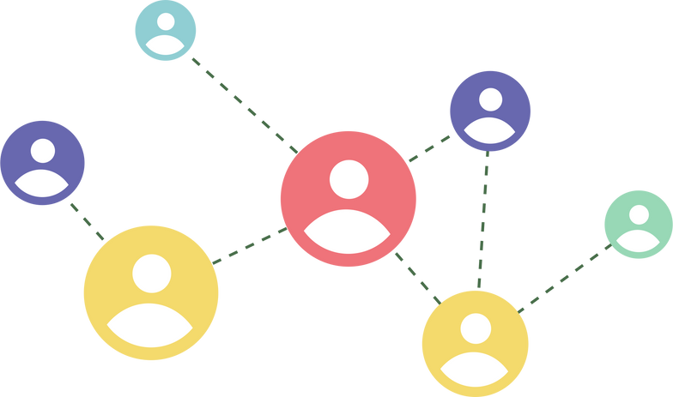
BUILDING (ON) LOCAL STRUCTURES
Which networking opportunities exist in your region?
What are important aspects of civic engagement on the local level?
Using the internet for civic engagement

Slide 13
Which networking possibilities exist?
Local or nationwide professional networks
Regional policy networks
Migration policy networks
International networks
For more information on networking, you can also check out the module networking & advocacy
For Example
Include country and regional specifics and examples for networks
Committees, advisory boards, working groups and expert forums
Political parties, foundations
Municipal migration/integration advisory boards
Advisory boards of other political and administrative sectors
Universities
Other migrant organisations

Slide 14
Using the Internet for Civic Engagement
Online advocacy campaigns and fundraising can help find new cooperation partners and increase the interest of the general public in your issue!
The essential tools for this kind of strategy are:
e-mails: software like Mailchimp and Mail Merge if you want to reach a great number of people (easy and effective)
social media: Facebook, Twitter, Instagram, YouTube and so on can reach a larger audience; and a fast distribution of your message and support for your issue
online advertisements: e.g. e-mail marketing, mobile advertising and social media marketing (depends on budget and specific target).
"The importance of communicating through social media has been growing over the years, underling different possible ways to influence and engage with decision-makers." (Jean Monnet Professor Alberto Alemanno, 2019, The Guide to citizen lobbying, page 9, https://www.thegoodlobby.eu/wp-content/uploads/2019/07/Toolkit-EU.pdf
Source: https://www.thegoodlobby.eu/wp-content/uploads/2019/07/Toolkit-EU.pdf

Slide 15
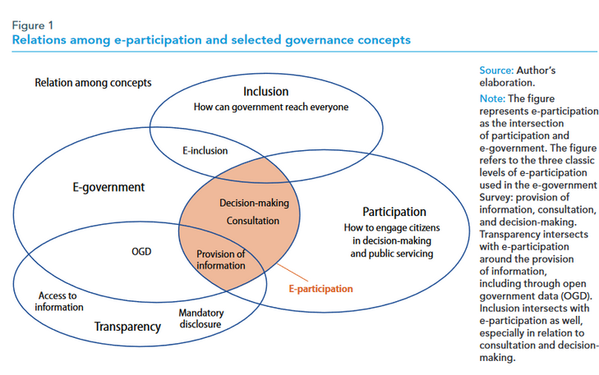
E-Participation (1)
Definition used by the United Nations:
“the process of engaging citizens through ICTs in policy, decision-making, and service design and delivery so as to make it participatory, inclusive and deliberative” (UN, 2014, E-Government for the Future We Want, E-Government Survey 2014, Department of Economic and Social Affairs, New York)
Source:https://www.un.org/esa/desa/papers/2020/wp163_2020.pdf

Slide 16
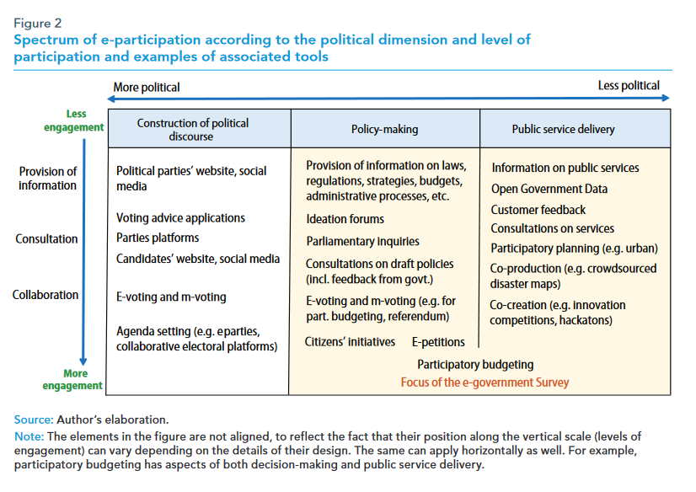
E-Participation (2)
Source:https://www.un.org/esa/desa/papers/2020/wp163_2020.pdf

Slide 17
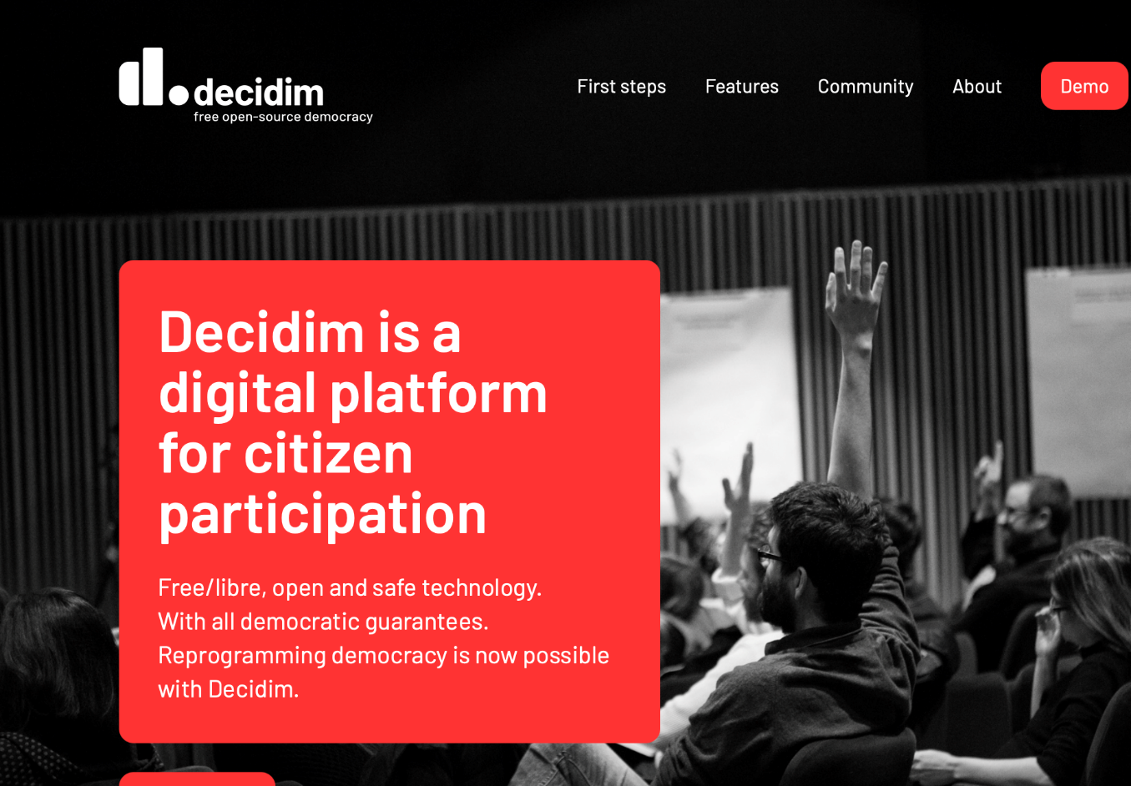
E-Participation (3)
Give a brief introduction to EMVI‘s e-participation platform and its adapted version for the local context
Show also other examples of particiaption websites like:
https://mein.berlin.de/ or https://beteiligungsportal.baden-wuerttemberg.de/de/startseite/

Slide 18
More than 3
10-30 minutes, depending on motivation
Dealing with multilingualism in a group.
Exchanging about the different terms and social contexts of meaning or attributions.
Understanding individual and societal ideas of democratic
culture, "social participation" and " political participation".
Two large sheets of paper (A1) and thick pencils
METHOD: How to participate on an e-plaform
3-30 People
20 min introduction by the moderator
15-20 min exercise (group work if needed)
Instructing how to use an e-participation platform (EMVI platform or other)
Writing policy suggestions and comments
Discussing opportunities and challenges of e-participation
Laptops and a projector
Description of the method: Show the participants how to use an e-participation platform. Explain the different tools they can use. Encourage the group to choose a policy-related topic that they want to discuss online. Give them the opportunity to discuss it and to publish directly on a platform or let them write a comment as example. Discuss then the different challenges and opportunities of e-participation.

Slide 19
FURTHER LINKS
Building (on) Local Structures:
https://www.progressives-zentrum.org/the-european-hub-for-civic-
engagement/
E-Participation:
https://www.un.org/esa/desa/papers/2020/wp163_2020.pdf
https://www.stadt-zuerich.ch/prd/en/index/urban-development/socio-spatial-development-unit/inclusion-of-quarters/participation-processes/e-participation.html
https://www.europarl.europa.eu/RegData/etudes/etudes/join/2011/471584/IPOL-JOIN_ET(2011)471584_EN.pdf
https://docs.decidim.org/en/features/participatory-spaces.html
https://futureu.europa.eu/?locale=en

