Slide 1
Discrimination and Empowerment
The project is co-funded by the European Unions‘ Asylum, Migration and Integration Fund. The content of this presentation represents the views of the EMVI project partnership only and is their sole responsibility. The European Commission does not accept any responsibility for use that may be made of the information it contains.

Slide 2
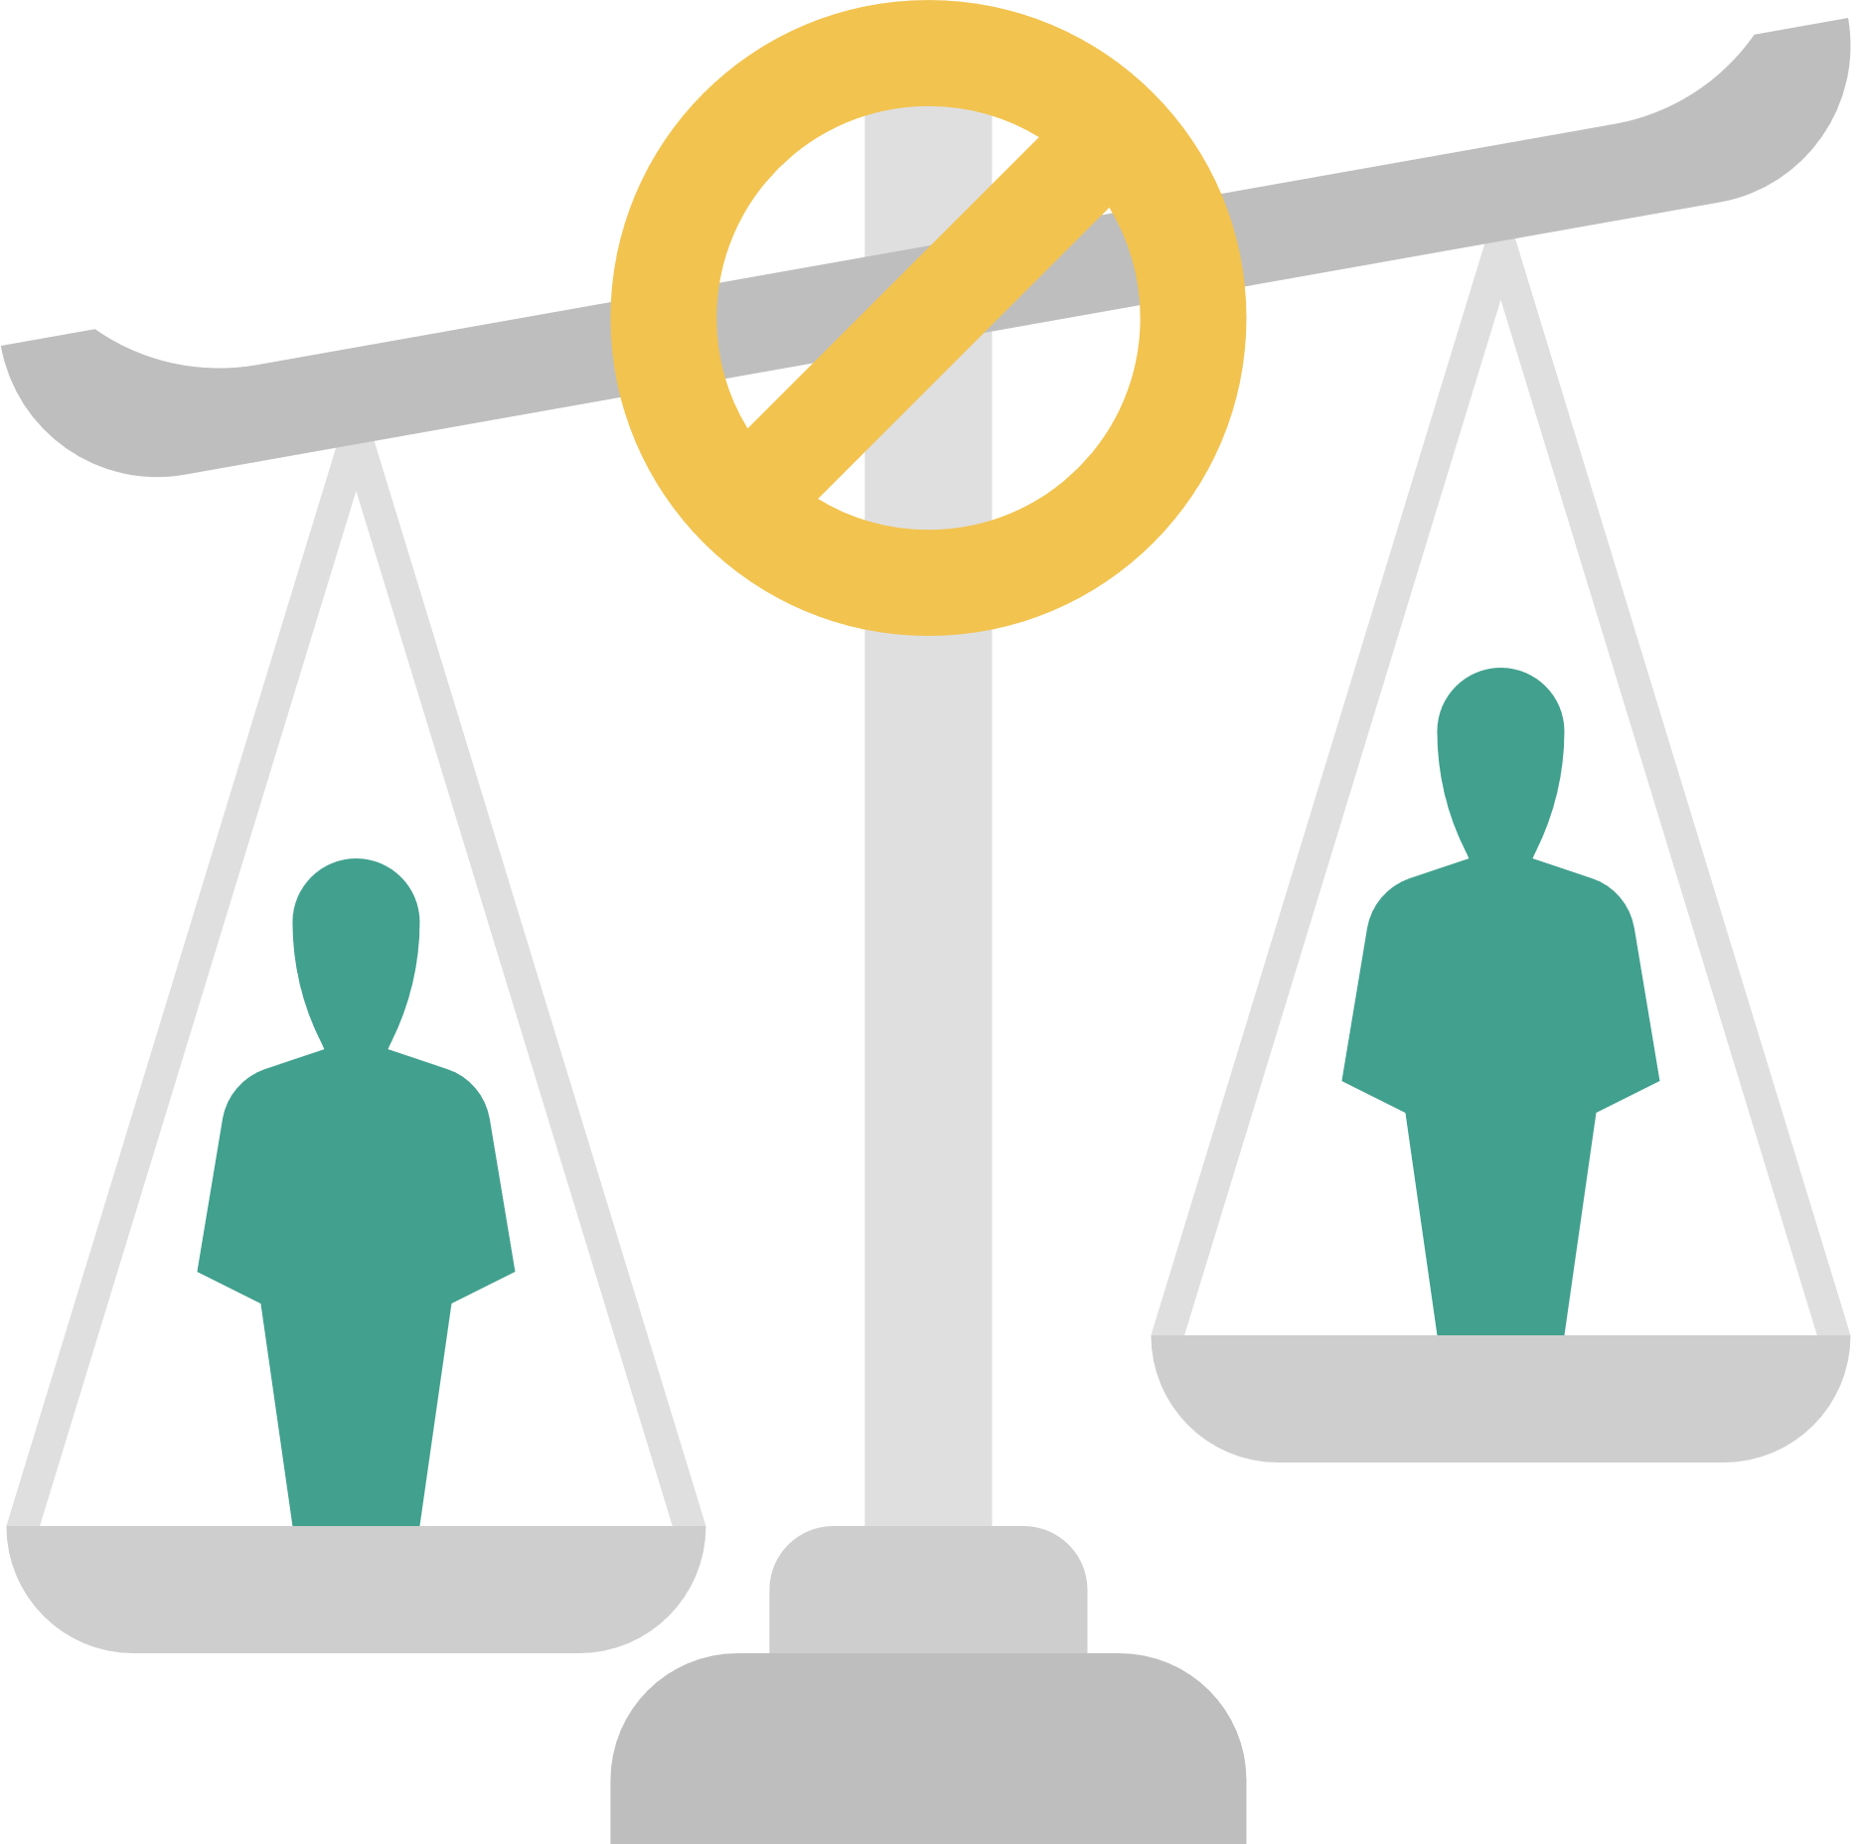
WHAT IS DISCRIMINATION? (1)
Unequal treatment of an individual or
groups of people, on the basis of certain characteristics
Discrimination takes place on different levels:
Individual
Institutional
Structural
Discursive
Source: Marcus Osei & Hartmut Reiners, ARIC-NRW e.V., Training series on anti-discrimination work for Bunsverband Bundesverband Netzwerke von Mirgant*innenorganisationen (NeMO)

Slide 3
WHAT IS DISCRIMINATION? (2)
Social Power relations
Racism
Sexism
Heterosexism (against lesbians, gays, trans people)
Ableism (against people with disabilities)
Social status
Intersectional discrimination
Form, action,
Impact:
Discrimination
Source: Marcus Osei & Hartmut Reiners, ARIC-NRW e.V., Training series on anti-discrimination work for Bunsverband Bundesverband Netzwerke von Mirgant*innenorganisationen (NeMO)

Slide 4
RACIAL DISCRIMINATION
International Convention on the Elimination of All Forms of Racial Discrimination (1996) Article 1 (1)
[...] the term "racial discrimination" shall mean any distinction, exclusion, restriction
or preference based on race, colour, descent, or national or ethnic origin which has the purpose or
effect of nullifying or impairing the recognition, enjoyment or exercise, on an equal footing, of human
rights and fundamental freedoms in the political, economic, social, cultural or any other field of public
life.

Slide 5
WHAT IS DISCRIMINATION? (3)
Levels of Discrimination
Individual/everyday life: Attitudes, feelings and prejudices lead to
discriminatory statements or actions on a personal level between individuals.
Institutional
Institutionalised processes and structural barriers, which are often invisible, lead to disadvantage.
Structural
Inequalities generated by the social system with its
norms and its political and economic structures have an impact on
organisations, which can lead to entrenched habits, established
action patterns.
Discursive
Discriminations are created by social value and norm propositions,
the thinking and talking about "us" and the "others" in science, literature, the media, politics or in private circles.
Source: Marcus Osei & Hartmut Reiners, ARIC-NRW e.V., Training series on anti-discrimination work for Bunsverband Bundesverband Netzwerke von Mirgant*innenorganisationen (NeMO)

Slide 6
DISCRIMINATORY GROUNDS (ACTUAL OR ASSUMED)
Age = young age, old age, age limits, etc.
Disability and chronic illness = physical impairment and
chronic illnesses, impairments of the perceptive and expressive faculty
expression, sensory perceptions, mental impairments, etc.
mental impairments
Gender = female, male, pregnancy; transsexual, transgender,
transident, intersex, etc.
Nationality and ethnicity = ethnic affiliation/attribution,
origin, external appearance, skin colour, language, name, migration history,
migration background, etc.
Religion or world view = religious affiliation, membership of a
worldview, denomination, atheism
Sexual identity = gay, lesbian, bisexual, etc.
Source: Marcus Osei & Hartmut Reiners, ARIC-NRW e.V., Training series on anti-discrimination work for Bunsverband Bundesverband Netzwerke von Mirgant*innenorganisationen (NeMO)

Slide 7
STRUCTUAL DISCRIMINATION
Structural
Inequalities generated by the social system with its
norms and its political and economic structures have an impact on
organisations, which can lead to entrenched habits, established
action patterns.
A very important concept is Social Justice
"The term social justice refers to a specific way of thinking about justice that simultaneously considers the distribution, recognition, empowerment and realisation of rights." (p. 24 Leah Carola Czollek et al., Praxishandbuch
Social Justice und Diversity Theorien, Training, Methoden, Übungen
2., vollständig überarbeitete und erweiterte Auflage, 2019 Beltz Juventa)
Suggested Authors:
Leah Carola Czollek et al., Praxishandbuch
Social Justice und Diversity Theorien, Training, Methoden
Iris Marion Young, Book Justice and the Politics of Difference
Hannah Arendt, Essay We Refugees as well as other Publications
Here, we recommend also including national and local examples of social movements, projects and methods to overcome structural discrimination.

Slide 8
INTERSECTIONAL DISCRIMINATION
...looks at how actual or assumed identity markers or affiliations intertwine to form unique forms of discrimination.
Analysing discrimination only one-dimensionally overlooks the experiences of those who face the compounding of discriminatory grounds.
Kimberlé Crenshaw, is the leading professor of Law at UCLA and Columbia Law School & executive director of the African American Policy Forum. She explains intersectionality in this video: https://www.youtube.com/watch?v=xh2Z4XoCPLU
Further Reading:
Kimberlé Crenshaw,
https://www.oxfordpublicphilosophy.com/philosophers-racialised-as-black/kimberl-w-crenshaw
Factsheet - Race in Germany and Europe, Center for Intersectional Justice e.V.:
https://drive.google.com/file/d/1LR1q6XX5AAjGFF4BU2Ks-MKcct46UKS0/view
Source: Marcus Osei & Hartmut Reiners, ARIC-NRW e.V., Training series on anti-discrimination work for Bunsverband Bundesverband Netzwerke von Mirgant*innenorganisationen (NeMO)

Slide 9
WHAT CAN YOU DO IF YOU EXPERIENCE DISCRIMINATION?
Introduce advisory and support centres or any other institutions and organisations where to get help
Write a report from your memory of what, when and where it has happened. This helps you to remember important details which may get confused after some time. This is important if you want someone to explain the situation or when you want to sue the person/institution for compensation
CLARIFICATION IN CASE OF DISCRIMINATORY INCIDENTS
1. Where did the discrimination take place?
2. What exactly happened?
3. Who was involved in the incident?
(Person responsible for discrimination, person affected, witness)
4. What form of discrimination occurred?
5. To which characteristic(s) was the discrimination linked?
6. What were the consequences of the discrimination for you or the victim?
Source: Marcus Osei & Hartmut Reiners, ARIC-NRW e.V., Training series on anti-discrimination work for Bunsverband Bundesverband Netzwerke von Mirgant*innenorganisationen (NeMO)

Slide 10
INTERNATIONAL AND NATIONAL FRAMEWORK TO FIGHT DISCRIMINATION
General Information on Discrimination Issues in the European Union:
European Union Agency for Fundamental Rights
https://fra.europa.eu/en/themes/equality-non-discrimination-and-racism
Include information on regional specificities and in the national language as well as in other languages spoken by migrants.
EU Anti-Discrimination Law (E-Learning Modules)
https://www.era-comm.eu/anti-discri/e_learning/overview.html
The Directives on Equal Treatment of the European Union
https://www.antidiskriminierungsstelle.de/EN/about-discrimination/order-and-law/directives-of-the-eu/directives-of-the-eu-node.html
Where to get help when you feel discriminated (by EU Country):
https://fra.europa.eu/en/about-fundamental-rights/where-to-turn
Anti-discrimination Advice and Support Centres (Country Specific)

Slide 11
HUMAN RIGHTS OBLIGATIONS
IN THE PROTECTION AGAINST DISCRIMINATION
International Convention on the Elimination of All Forms of Racial Discrimination
EU Reception Directive
EU Qualification Directive
International Covenant on Civil and Political Rights, ICCPR
EU Procedures Directive
European Convention on Human Rights (ECHR)
International Covenant on Economic, Social and Cultural Rights, ICESCR
Charter of Fundamental Rights
UN Convention on the Rights of Persons with Disabilities (CRPD)
Universal Declaration of Human Rights (UDHR)
UN Convention on the Rights of the Child
Geneva Refugee Convention
The Convention on the Elimination of All Forms of Discrimination against Women (CEDAW)
Source: Marcus Osei & Hartmut Reiners, ARIC-NRW e.V., Training series on anti-discrimination work for Bunsverband Bundesverband Netzwerke von Mirgant*innenorganisationen (NeMO)

Slide 12
NATIONAL FRAMEWORK AGAINST DISCRIMINATION
Where to get help when you feel discriminated (by EU Country):
https://fra.europa.eu/en/about-fundamental-rights/where-to-turn
German Brochure Protection against Discrimination: A Guide for Refugees and New Immigrants
Show here what national and regional laws, policies and approaches are available to reduce discrimination.
https://www.antidiskriminierungsstelle.de/SharedDocs/downloads/DE/publikationen/Refugees/fluechtlingsbroschuere_englisch.pdf?__blob=publicationFile&v=5
The Federal Anti-Discrimination Agency
https://www.antidiskriminierungsstelle.de/SharedDocs/downloads/DE/publikationen/Flyer/die_antidiskriminierungsstelle_stellt_sich_vor_englisch_barrierefrei.pdf?__blob=publicationFile&v=3
Introduce advisory and support centres or any other institutions and organisations where to get help

Slide 13
METHOD : STRUCTURAL DISCRIMINATION: MECHANISMS, PRACTICES, FUNCTIONS (TALKING ABOUT DIFFERENT FORMS OF DISCRIMINATION)
Description of the method:
The participants are then asked to find concrete examples of the individual points, which they present to the whole group.
During this exercise, participants deal with mechanisms, practices, functions and consequences of structural discrimination. For this purpose, a worksheet is handed out and discussed which contains the following points:
1. Mechanisms and Practices of Structural Discrimination
Making people Other by means of stereotyping (Othering)
Attribution of identity
Devaluations
Contempt
Control
Stigmatisation
Insults
Disparagement
Use of violence
Disrespect towards the individual
Use of coercion
2. Functions of these practices
Maintaining one's privileges
Legitimisation of social positions
Consolidation of own identities
Establishment of social norms and national
and group-specific homogeneity
Maintenance of unequal distribution of resources
3. Backgrounds
Historical anchoring of stereotypes
in the discrimination matrix, which are part of
current forms of structural discrimination
Worldviews to which concepts of truth,
concepts of truth, unity and totality are
underlying
Social, structurally anchored hegemony
(supremacy) in the context of power and
of power and domination relations as a
standard and norm
Reproduction at individual,
institutional, and cultural level
20 minutes to 40 minutes Group work approx. 15 to 20 minutes, presentation approx. 5 minutes per working group, evaluation approx. 10 minutes
3-30 People
Promote discussion of concepts and conceptual fields.
Stimulate exchange and communication processes between several people.
Clarify and define concepts.
Flipchart paper or other large paper (A2) for group work, wide pens, tape/pens or pin board with pins.
Leah Carola Czollek et al., Praxishandbuch
Social Justice und Diversity Theorien, Training, Methoden, Übungen
2., vollständig überarbeitete und erweiterte Auflage, 2019 Beltz Juventa, Page 69

Slide 14
METHOD: DEVELOPMENT OF COMMUNICATION AIDS
Description of the method:
Work together to develop criteria for a good discussion atmosphere. The moderator should make suggestions, which the participants can then expand.
The following suggestions can be listed, for example:
I formulate my own boundaries: what do I want to share with the others and what not.
I speak of my own experiences.
I avoid generalisations.
I treat different perspectives respectfully and politely.
I leave personal information from others in the group.
I share pauses of silence as a time to take a breath and reflect.
I do not shame or scapegoat anyone.
I share the background to my questions.
I put the focus on my own learning.
I take responsibility for my speaking time and for what I say.
What else is important to you?
The suggestions for additions and changes are presented to the plenary
and taken up.
3-30 People
20 minutes together with the whole group
Participatory development of the training
Creation of a relaxed atmosphere in which everyone can speak openly
Discussion of boundaries
Helping to understand non-discriminative communication and empowerment
Flipchart paper or other large paper (A2), wide pens, tape/pens or pin board with pins.
Leah Carola Czollek et al., Praxishandbuch
Social Justice und Diversity Theorien, Training, Methoden, Übungen
2., vollständig überarbeitete und erweiterte Auflage, 2019 Beltz Juventa, Page 65

Slide 15
WHAT IS EMPOWERMENT?
“(…)empowerment is aimed at encouraging social participation. Empowerment approaches entail providing spaces for people to discover their resources and enabling them to become active agents within their own lives. This does not primarily refer to imparting knowledge and strategies from the outside, so to speak, but rather to jointly develop these on the basis of the experience and knowledge of the participants. Empowerment is not a uniform concept, but a range of different resource-oriented approaches that, building on the exchange of experiences, are geared towards opening up individual and collective opportunities for action in dealing with social power relations. Aspects of empowerment have already been applied in a variety of contexts by different actors. They became known in particular as a result of their use by the civil rights movements of the 1960s.”
(Quoted from: Prange, Christian et al., 2013. Brochure ”Good Practice Approaches – Ways to Combat Racism in
Your City ‘ECAR – European Cities against Racism’ Project “, page 55. https://ec.europa.eu/migrant-integration/integration-practice/good-practice-approaches-ways-combat-racism-your-city-ecar-european-cities_en. Accessed 27 October, 2022. )

Slide 16
Example: HAKRA Empowerment Concept
(Empowerment Approach from the PoC Perspective ) (1)
Individual and collective self-empowerment, self-determination, networking and strengthening of the the socio-political participation of People of Colour
Creating a dialogue between people of colour and members of the majority society
Power-Sharing approach: critique of social inequality in terms of resources, privileges and power, power-sharing (redistribution of power) on the part of the white dominant society.
The critical whiteness approach of the Critical Whiteness Studies from the US-American context (critically expanding the view from those affected by racism, as represented in Black Studies, to the white society practising racism and its actors).
Halil Can 2013. Empowerment aus der People of Color-Perspektive Reflexionen und Empfehlungen zur Durchführung von Empowerment-Workshops gegen Rassismus, Senatsverwaltung für Integration, Arbeit und Soziales Landesstelle für Gleichbehandlung – gegen Diskriminierung (LADS)
pages 11-12. https://www.eccar.info/sites/default/files/document/empowerment_webbroschuere_barrierefrei.pdf. Accessed: 27 October, 2022.

Slide 17
Example: HAKRA Empowerment Concept
(Empowerment Approach from the PoC Perspective ) (2)
Guiding Principles
Awareness and visualisation and finally (re)activation of (own) resources
Creation of multi-protected spaces by and for people of colour, in which a dialogue and solidary dialogue can be experienced
Principle of equality in diversity and diversity in equality (everyone in diversity is different and at the same time can be similar) – “multi-perspectivity” and “transculturality”
Concept of process orientation (nothing is static, thus everything is in motion and changeable)
Holistic perspective future-oriented yet aware of the past (bond of generations)
Networking and Exchange (“collective building of resources”)
Halil Can 2013. Empowerment aus der People of Color-Perspektive Reflexionen und Empfehlungen zur Durchführung von Empowerment-Workshops gegen Rassismus, Senatsverwaltung für Integration, Arbeit und Soziales Landesstelle für Gleichbehandlung – gegen Diskriminierung (LADS)
pages 11-12. https://www.eccar.info/sites/default/files/document/empowerment_webbroschuere_barrierefrei.pdf. Accessed: 27 October, 2022.

Slide 18
METHOD: Postcards (Empowerment Workshop)
Make sure that you create a safe space only for BPoC/BIPoC or PoC people (consider also to hire a trainer corresponding to this criteria)
3-15 People
20 minutes together with the whole group
Description of the method:
Getting to know each other
Helping to understand why someone participates in this workshop
Learning something about the trainer
The group with the trainer should sit in a circle. Let everyone write on postcards: One’s own motivation, wishes, expectations and fears (related to the training but also more general
Let everyone present the cards
The trainer can also make cards to explain its motivation for becoming an empowerment trainer
At least one postcard per person
Halil Can 2013. Empowerment aus der People of Color-Perspektive Reflexionen und Empfehlungen zur Durchführung von Empowerment-Workshops gegen Rassismus, Senatsverwaltung für Integration, Arbeit und Soziales Landesstelle für Gleichbehandlung – gegen Diskriminierung (LADS),
page 18. https://www.eccar.info/sites/default/files/document/empowerment_webbroschuere_barrierefrei.pdf. Accessed: 27 October, 2022.

Slide 19
METHOD: Biographical Work
(Empowerment Workshop for Women of Colour)
Make sure that you create a safe space only for BPoC/BIPoC or PoC people (consider also to hire a female trainer corresponding to this criteria)
3-15 People
Description of the method:
There are two phases of biographical work.
Part 1: Life Line
Each participant should first reconstruct her own life line in individual work and depict three phases of life by illustration or with family photos. In the next step, the biographical testimonies, i.e. drawings, graphics, photos, dates, should be presented in the group.
Part 2: Model of Stages
describes in a simplified way the processes of identity negotiation
1. white-oriented phase2. confrontation phase 3. integration phase/disintegration phase/immersion – emergence 4. integration phase 5. self-determination/concrete action. The phase model describes a conflictual identity negotiation process of BPoC (can also be used as a method for PoC) who are confronted with racism in everyday life. The different stages are not meant to describe a linear process but should visualise the struggle in the identity process in order to reflect on their own situation. This is meant as an exercise to show the process from ascription to self-attribution. On the same time it should create awareness of self-empowerment and collective solidarity among the participants
3-6 hours (depending on capacity)
Learning about and from the experiences of others
Sharing of experiences of discrimination (racism, sexism e.g.)
Understanding the identity struggles and baths to one’s own identity
Self-empowerment
Paper and Pens
Halil Can 2013. Empowerment aus der People of Color-Perspektive Reflexionen und Empfehlungen zur Durchführung von Empowerment-Workshops gegen Rassismus, Senatsverwaltung für Integration, Arbeit und Soziales Landesstelle für Gleichbehandlung – gegen Diskriminierung (LADS)
pages 19. https://www.eccar.info/sites/default/files/document/empowerment_webbroschuere_barrierefrei.pdf. Accessed: 27 October, 2022.

