Slide 1
GENDER EQUALITY & Combatting Gender Based Violence – a cross cutting challenge for all – migrants and locals!
The project is co-funded by the European Unions‘ Asylum, Migration and Integration Fund. The content of this presentation represents the views of the EMVI project partnership only and is their sole responsibility. The European Commission does not accept any responsibility for use that may be made of the information it contains.

Slide 2
Gender equality
Equality between women and men: an important area for the EU, UN, etc for a long time
Legal status of women in Europe has greatly improved, but no de facto equality between women and men

Slide 3
Migrant, refugee and asylum-seeking women and girls
Exposed to gender-based violence in their country of origin, during the journey to Europe, or upon arrival
Protection & reception: Victims of violence against women and domestic, of trafficking, gender-sensitive asylum procedures and reception facilities
Residence and integration: access to social services; social and political participation; employment; education & training; integration policies; family reunification

Slide 4
What is the gender pay gap in Europe (EU)?
9%
16%
44%
Notes:
Greece 12,5%

Slide 5
How much time do women spend compared to men in household and care work in the world?
The same time
2,5 times more
4 times more

Slide 6
How many women in the EU have experienced in the EU-27 have experienced sexual harassment since the age of 15?
1/5
1/3
1/2

Slide 7
Notes:
Greece 25%

Slide 8
Notes:
En quoi l’inégalité est problématique…

Slide 9
Gender equality
How to understand gender inequalities?
We have not achieved gender equality. This is supported by research and statistics.
Gender is an area of knowledge. There is also a research field: gender studies.
Important to look at both the public and private sphere, including unpaid care work
Need for an intersectional perspective
Gender equality concerns both women and men. Not only a women issue!
Gender equality concerns all institutions and all areas

Slide 10
Combat gender stereotypes and sexism
Gender stereotypes are present in all areas of life Obstacle to gender equality & feeds into gender discrimination
Gender stereotypes in education: content of teaching material, curricula, teaching methods, career and study advice etc
Media: women 24% of the persons heard, read about or seen in the news - even less as experts: 17%
Looking at regulatory frameworks on the content of media in relation to human dignity, gender equality, violence against women+ encourage media auto regulation (Istanbul Convention)
Media as a profession: more women but under-represented in decision-making and ownership

Slide 11
Ensuring women’s equal access to justice
Obstacles to women’s access to justice :
Limited use of international standards in judicial decisions
Low awareness of and limited remedies for indirect discrimination of women
Violence against women: not all forms are criminalised; severe under-reporting of crimes of violence against women;
Scarce or no state funding for support services in some countries
Europe: equal number of women and men judges but glass ceiling in the judiciary
Notes:
A new assessment report on 45 European judicial systems, prepared by the European Commission for the Efficiency of Justice (CEPEJ) of the Council of Europe, finds that although there is parity, on average, between male and female judges in all jurisdictions, there is a decrease in the percentage of female judges as we move up in the judicial hierarchy. Parity is still difficult to achieve as far as the presidents of courts are concerned 67% men.
EX rape: in some European countries condamnation in less than 5% of rapes,

Slide 12
Ensuring women’s equal access to justice
Important obstacle: Judicial stereotyping:
“The practice of applying a stereotypical belief to an individual member of the subject group”
Stereotype: Generalised belief or preconception about sex or gender
Assumptions about the attributes, characteristics and roles of women and men as a group
Inferences about individual women and men
Notes:
Gender stereotypes and bias in the justice system (ex.: investigation of sexual violence). Compounded by other stereotypes (age, ethnicity, social status)

Slide 13
Ensuring women’s equal access to justice
Stereotype: women belong in the home
Assumptions about women as a group: women should avoid the public space, especially if they are alone and/or at night
A woman walking in the street at night ‘provoked’ sexual assault and must accept blame
A women having this attitude is a less credible witness.
Possible conclusions in a court:

Slide 14
Ensuring women’s equal access to justice
Effects of judicial stereotyping:
Stereotyping can compromise the impartiality of judges’ decisions
Stereotyping can affect the views of judges about witness credibility and legal capacity
Stereotyping can stop judges holding offenders legally accountable
Stereotyping can in practice block access to legal rights and protection

Slide 15
Ensuring women’s equal access to justice
Suggested actions:
Ensure the full implementation of legislation
Measures to address judicial stereotyping (research, monitoring, education)
Secure access to appropriate legal aid and representation for women, in particular victims of gender-based violence;
Develop and deliver training on gender-based violence, gender equality and women’s human rights, tailored to the needs of justice professionals

Slide 16
Balanced participation of women and men in decision making
Political decision- making:
Parliaments: 25% women
Ministers: 25% women
Mayors: 15 % women (EU countries)
17 countries have introduced legislative electoral quotas
In 17 countries, some or all political parties have introduced voluntary quotas
Notes:
Greece 22% MPs, 18% mayors
Greece (Hellenic Republic) has a Unicameral parliament with the use of voluntary party quotas and legislated quotas for the single/lower house and at the sub-national level. 65 of 300 (22%) seats in the Vouli Ton Ellinon / Hellenic Parliament are held by women.
40% quota for electoral lists for the candidates at all electoral procedures (national, regional, municipal and European elections). but no placement rules and no impact on funding of political parties

Slide 17
Balanced participation of women and men in decision making
Other areas of decision-making:
Women on boards (large publicly listed companies): from 11.9 % in 2010 to 30 % in 2020 (EU countries)
Senior administrators in public administration: 34% women (EU countries)
Media sector - public broadcasters: presidents and members of the board/council : 37% women (EU countries)
Notes:
Greece = 13% women on board
17% in public broadcasters

Slide 18
Balanced participation of women and men in decision making
Gender equality in decision-making = primarily a question of justice
Council of Europe Recommendation (2003)3 on balanced participation of women and men in political and public decision making: neither sex should be represented in a political or public decision-making body at a level below 40%

Slide 19
Balanced participation of women and men in decision making
Gender quotas/parity measures are introduced in more and more countries and are effective
Factors to be addressed:
Electoral systems
Political parties as gatekeepers
Functioning of political life
Promotion and quotas in companies
Norms and expectations regarding women and men
Going beyond numbers and changing policies!
Notes:
Progress, but very slow

Slide 20
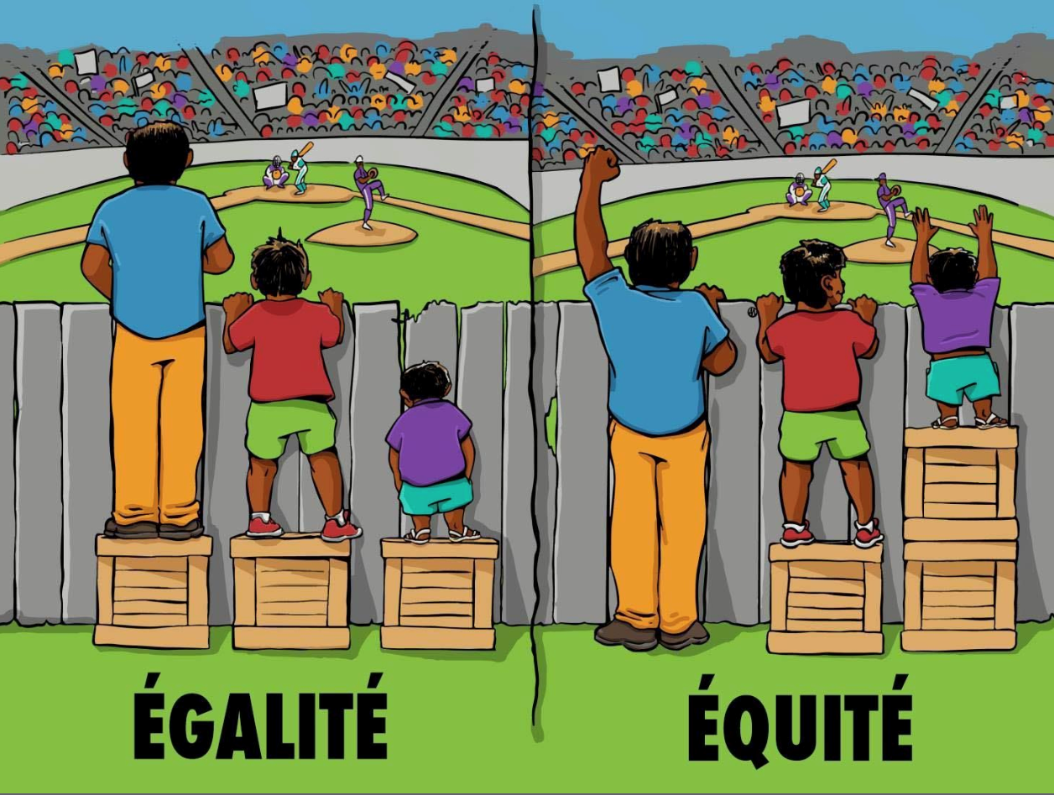
Gender mainstreaming at the Council of Europe

Slide 21
Gender mainstreaming at the Council of Europe
Gender mainstreaming: why?
Research and statistics show that equality between women and men is not a reality in Europe today
Making sure that women and men are equally represented in different bodies and institutions: a question of justice but not the only solution
We live in a society where gender plays a structuring role

Slide 22
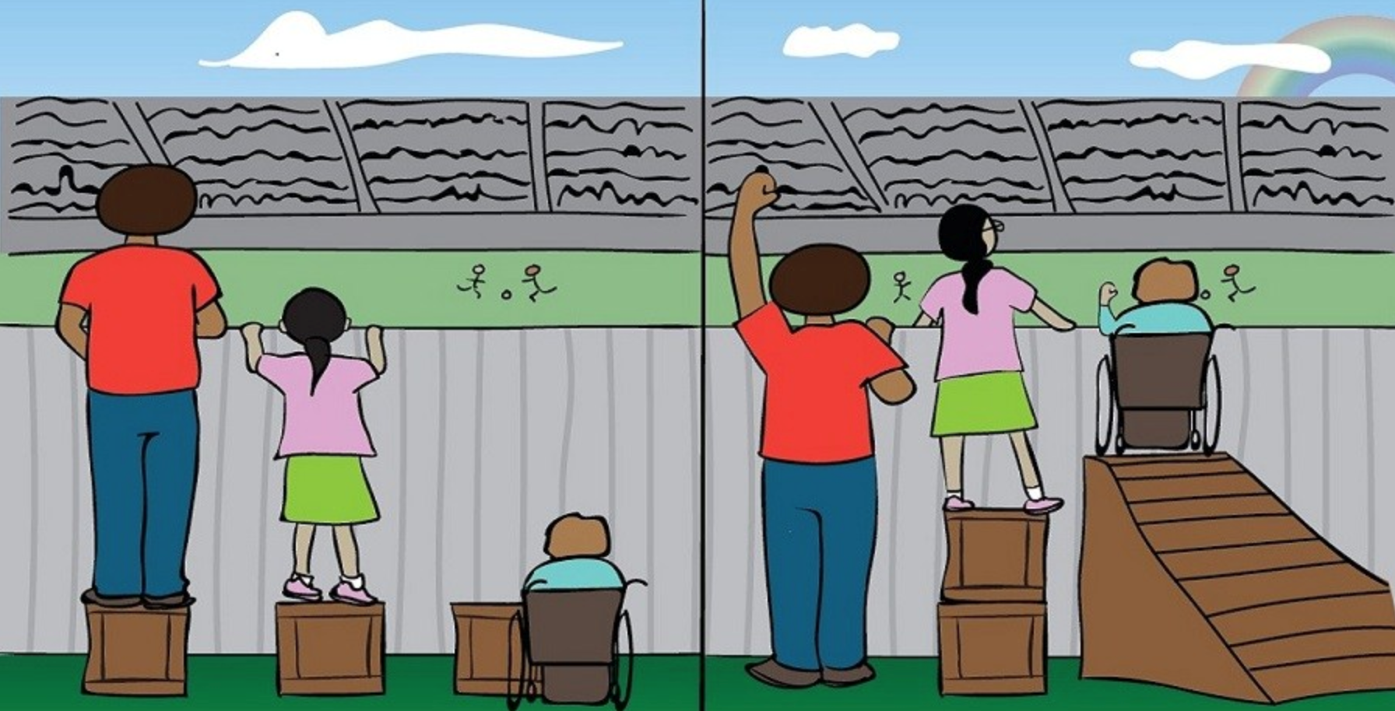
Gender mainstreaming at the Council of Europe

Slide 23
What does Gender Mainstreaming mean?
Grounding policies on the concrete situation and needs of both women and men
Better informed policy-making
Challenging the gender neutrality of policies
Not an end in itself, the final aim is to promote gender equality

Slide 24
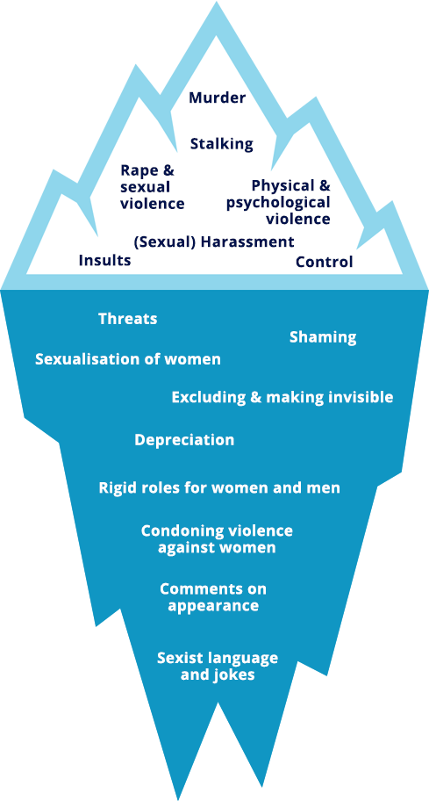
Prevent and combat violence against women
1 woman in 3 confronted with violence since she was 15
Continuum of violence
Present in all areas
Notes:
Le sexisme crée un climat qui conduit à accepter la violence
Iceberg de la violence: toutes les violences sont liées - on ne s’interresse au bas que depuis peu (CI)
Violence envers les hommes également mais assymétrie des rapports de pouvoir
Quand cela a commencé, la menace fait le même effet que le coup porté en elle –même
But = montrer qui domine, la violence n’intervient que si la femme résiste
Emprise: phénomène de décervelage, l(auteur fait en sorte que l’entourage disqualifie la femme victime qui finit par douter de son propre ressenti et perdre son esprit critique
Phènomène d’impuissance apprise, les femmes deviennent passives
4 P: prévention, protection, poursuites, politiques intégrées (co-ordinated and comprehensive, in that they encompass all relevant measures to prevent and combat all forms of violence against women. )

Slide 25
Istanbul Convention (2011):
A grey area: no legally-binding instrument on violence against women (VAW) in Europe
The absence of a global instrument, such as a UN treaty to establish States’ positive obligations to prevent, prohibit and punish VAW.
EU signature in 2017
Criminalises different forms of VAW
Based on 4 p’s approach: prevention, protection, prosecution, integrated policies
Notes:
Based on the idea that gender-based violence is a form of discrimination against women and links the achievement of gender equality to the eradication of violence against women, and vice versa
→ The Convention on the Elimination of All Forms of Discrimination Against Women (CEDAW) covers VAW through its General Recommendation No.35, updating General Recommendation No.19
→ The 1993 UN Declaration on the Elimination of VAW addresses VAW and domestic violence but remains non-binding
Other regional instruments already existed in Latin America and Africa
→ The Belem do Para Convention signed within the Organisation of American States (OAS) in 1994
→ The Maputo Protocol concluded within the African Union in 2003

Slide 26
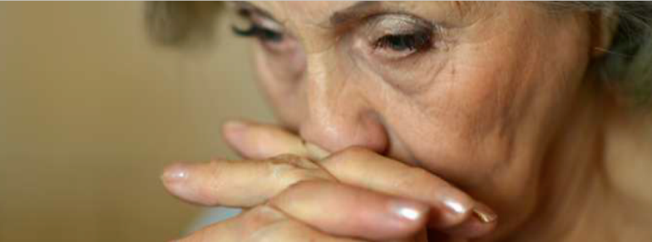
The Istanbul Convention: an Intersectional lens
• The Principle of non-discrimination
Article 4 ensures that the Istanbul Convention protects ALL women, irrespective of who they are and where they come from. When serving victims of VAW, there shall be no discrimination on the basis of their:
Special measures aiming to prevent VAW and protect women victims shall not be considered as ‘discrimination’ under the terms of the Convention
sex, gender, race, colour, language, religion, political opinion, national/social origin, sexual orientation, association with a national minority, property, birth, sexual orientation, gender identity, age, state of health, disability, marital status, migrant or refugee status, or other status.

Slide 27
Reducing migrant women’s dependence (art. 59)
Article 59 introduces the possibility of granting independent residence status to migrant women victims of VAW who derive their residence permit from their abusive spouse or partner.
It also requires States to suspend any expulsion proceedings originally initiated against their abusive spouses but which affect their victims too, and to enable victims to apply for an autonomous residence permit.
Two situations justify an independent residence permit: if the competent authority consider the victims’ stay as :
- necessary due to the victim’s personal situation
- necessary for the conduct of the investigation and the criminal proceedings
States shall also adopt measures for victims of forced marriage who, by being forced to live abroad, have lost their residence status in the country where they usually reside by helping them to re-obtain it.

