Slide 1
How migrant trainers can better plan job- oriented linguistic support sessions
The project is co-funded by the European Unions‘ Asylum, Migration and Integration Fund. The content of this presentation represents the views of the EMVI project partnership only and is their sole responsibility. The European Commission does not accept any responsibility for use that may be made of the information it contains.

Slide 2
According to the International Labour Organization (ILO), undeclared the work has a solid connection to migration. In many cases, migrant workers – primary migrants with an irregular or unauthorized status – are recruit- ed into undeclared work. They thus become vulnerable and subject to lower-level standards.¹
“Labour inspection in Europe: undeclared work, migration, trafficking”, International Labour Organization – Geneva,

Slide 3
Getting acquainted with the employment legislation core principles The aim is fundamental knowledge of labour rights. An indicative example is information on the working hours and the extra paid overtime, employment types, and paid leave. This being an informative task, the usage of the mother tongue is preferred to convey the meaning most efficiently. The tool will further highlight the responsibilities and rights of the employees and the employers. In this part, the discussion on employment legislation can take place as a trigger point for intercultural exchange. In many students’ countries of origin, citizens do not experience a transparent, fair and law-abiding society. This is an excellent opportunity for the learners to increase their awareness and competencies on democratic culture, rule of law and human rights, yet also to monitor their own inclusion in the labour market in the host country.

Slide 4
Tailor-made job-oriented linguistic support by migrant trainers
Employment opportunities and job offers to migrants and refugees constitute a significant component of their interaction with the host country. However, circumstances do not allow many opportunities for the learners to obtain a minimum level of L2. Frequently, the trainers follow a traditional methodology focused on language accuracy, which does not correspond to the learners’ needs. The learners, respectively, are moving constantly from place to place, pursuing one job offer after the other and a better future.
Tailor-made job-oriented linguistic support saves time, valuable both for employers and migrants/refugees, and is designed according to the learner’s needs, involving at the same time components of the local society. We estimate that for elementary occupations in Agriculture, Food and Natural Sources, Hospitality and Tourism, the learners can cope in a few months with the language barriers of L2 at a satisfactory level of communication.
1

Slide 5
Cooperate with the local community actors. Find the most offered and equivalent job positions which the local community can provide to migrants and refugees.
Ask the learners about previous work experiences. Find out the work preferences of each learner.
Inform them about labour legislation, obligations, and rights in a given job environment.
Enlist or record all the necessary communicative actions/ activities and the relative vocabulary used in the work- ing environment.
Visualise the material and create scenarios according to Step b. Use the job contract as learning material to distinguish the main points, such as working hours and type of employment.
Join the learners in their working environment for the
first days for hands-on tutoring, if possible.

Slide 6
Such practices, for example conducting a survey to verify the learners’ needs, and based on the outcomes to create hands-on scenarios, are not common among even migrant trainers of migrants/refugee students.
It takes time for people with migrant and refugee background to grasp and abide with the host country legislation, even if they acquire a sufficient level in L2.
Migrant educators should choose the relevant material carefully. Concerning the content accuracy of the labour rights scenarios, the educators could carefully choose material found on the internet, yet being aware that some discrepancies may occur. Before proceeding to the material de- sign, cross-checking for precision is essential to avoid potential misun- derstandings.
If some learners desire to obtain more details, we must refer them to job counsellors or lawyers. trainers must ensure whether the learners in their classroom wish to receive job-oriented linguistic support. Many migrants/refugees may be in a transit status and show disinterest in work at the given moment.

Slide 7
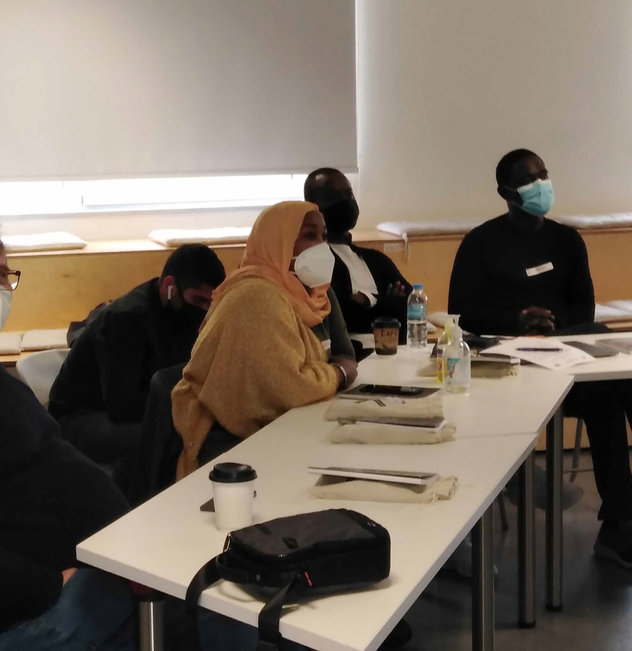
Interactive exercise
Proceed with a questionnaire addressed to refugee and migrant students to investigate if they are aware of any fundamental labour rights in the European Union, as well as which labour rights they consider essential.
This will be useful to draw up a short syllabus will guide the migrant trainers in creating a scenario for a soft skills course.

Slide 8
Migrant trainers working on migrant/refugee education and representatives of migrant communities can conduct the following:
Needs analysis by migrant teachers
All questionnaires should share standard demographic data such as country of origin, spoken languages, gender, years of employment in the resident country, and L2 language prior experience. The participants who answer the questions should be our students since this is about creating a custom-made procedure. The aim of the surveys is to gather essential data about the class, analyse the needs, and create custom-made mate- rial.
We suggest topics concerning the workplace, labour law, protection against discrimination, and social protection. The table below provides a deeper look inside the survey.
The last two questions are related to a comprehension aspect of the sur- vey. The participants have to choose which categories they consider the most significant and which of the above they would like to know more about.
Concerning job-oriented linguistic support, inquiries about the students’ language skills and the communication circumstances in which they are involved.

Slide 9
Examples
Survey content on ‘Labour rights’
Do you know...
the rules on your health and safety when you work?
that you have to wear special equipment in some jobs (e.g. construction, factories, various manual jobs)?
about the protection of pregnant workers and young
mothers?
what is ‘part-time work’?
what is ‘undeclared work’?
what is a strike?
that you are entitled to a day off every week?
2
International Labour Organization, Labour Administration and Inspection Programme LAB/ADMIN. (2010). p.38.

Slide 10
Examples
Questions on emotional status and language skills
On emotional status
Do you feel comfortable communicating with your
employer in L2?
Do you feel comfortable communicating with your colleagues in L2?
Do you feel that they understand you when you speak?
On language skills
Can you read signs or labels in L2 in your workplace?
Can you write notes in L2?
Do you talk with your colleagues in L2?

Slide 11
Step-by-step: Developing Questions
Of significant importance are the friendly, straightforward lay- out and the relevance of the questions. Ensuring that the mi- grant learners efficiently understand the survey’s content, and reading the questions without cultural mediator support is vi- tal. Since you are not an expert, do not emphasise details you may not comprehend. The survey’s scope is material creation, and thus the scenario design aims to educate migrant learn- ers on fundamental labour rights. For further detailed knowl- edge upon such issues, it is job counsellors or lawyers who must assist the learners. To run surveys among the learners, some examples are provided already in the Council of Europe LIAM Tool 24.
Labour Rights Surveys to be conducted by migrant trainers
Step 1: Identify the status of the migrant learners before surveying them. They may not have the same interests or occupation, i.e., some may be in transit and waiting to depart to another location.
Step 2: Get acquainted by running short research on the web about labour rights in the EU. (European Commission, Employment, Social Af- fairs & Inclusion).
Step 3: Obtain advice from employment experts to verify the survey’s
content accuracy.
Step 4: The first questions may have a demographic focus, i.e., country of origin, spoken languages, gender, literacy level, year(s) of prior job experience in a previous or current host country, or country of birth, etc. These questions may assist in comprehending better the survey’s out- come.
Step 5: Select three or four main topics concerning labour rights and emphasise further by asking for details, as suggested below.

Slide 12
Thematic areas
Relevant questions
☑ Do you know the regulations concerning
your health and safety when you work?
☑ Do you know that you have to wear special equipment for some tasks (e.g., construction, factories, various manual works)?
Workplace
☑ Do you have information about the protection of pregnant workers and young mothers?
☑ Do you know what is ‘part-time work’?
☑ Do you know what is ‘undeclared work’?
Labour Law
☑ Do you know that everyone has the right to work, regardless of religion, origin, gender, age, sexual orientation, disability?
☑ Are you informed about gender equality in the labour market?
Protection Against Discrimination
☑ Do you know what is ‘social security’?
☑ Do you know that you are entitled to health care when you work?
Social Protection
Step 6: Add questions about which subject is more significant to them,
and about which cases/situations they desire to learn more.

Slide 13
Linguistic Support Surveys
Step 1: Begin similarly with questions concerning demographic informa- tion. Concentrate additionally on questions around L2 background, their former learning experiences, and the work environment in which they will utilise the learning language content.
Step 2: Divide the questions into different thematic areas, e.g., work- place, communication with colleagues, communication with the employ- er, complications in using a language as a second/foreign (L2). A three- scale evaluation (e.g., efficient-acceptable-weak) concerning the learners’ self-assessment is suggested to get a more detailed outcome.
Thematic areas
Relevant questions
☑ Can you read signs or labels with words
in L2 at work?
☑ Can you write words in L2?
Workplace
Communication with colleagues
☑ Do you speak in L2 with your colleagues?
☑ Do you understand your colleagues when
they try to communicate with you in L2?
☑ Do you speak with your employer/
manager in L2?
☑ Do you understand your employer/ manager when they try to communicate with you in L2?
Communication with the employer
☑ Are you floundering in L2 when:
speaking
Complications in using L2
writing
reading
listening

Slide 14
Step 3: The thematic areas concerning communication with colleagues and employers should contain at least one question regarding the emo- tional reaction on behalf of the learner (e.g., how do you feel when you contact orally/communicate orally with your colleagues/employer?). The inconvenience of reacting in an L2 environment can lead to a lack of con- fidence, although the user has a sufficient L2 level.
Step 4: Do not forget to use open questions to locate their interest in lan- guage learning (e.g., which L2 skill would you like to train in more?).
Interactive exercise:
Practice by asking each other in group work on the terminology used, on whether migrants are familiar with the words used, and on conducting these surveys which should be the responsibility of migrant trainers, as they know best migrant needs.

Slide 15
Job Oriented Linguistic Support Scenarios The teaching scenarios on language and labour rights Migrant trainers can learn how to create a short syllabus by asking three questions: What (should I teach)? What (can I accomplish by teaching these topics)? How (I teach the relevant material)? How should I time my teaching in parts and how should I structure them? Activities to be conducted with migrant students: The activities should provoke the students’ memory and introduce them to the new information as a starting point to create learning motivations and more favourable conditions for the student’s acquisition of the cognitive subject. In the beginning, we intrigue the students about the content of the new sub- ject, using educational techniques that will pleasantly surprise them and mobilise their continued interest (e.g., the method of automatic writing, brainstorming, role-play etc.). The scenarios concerning Labour Rights should have at least four activities regarding the duration and students’ motivation. In the warm-up phase, the educator could display photos of working people, pregnant workers, and parents with young children working from home. Then the students should recall the vocabulary they already know while the migrant trainers write down the keywords on the board. Using photos can encourage students to recognise and comment on the situation

Slide 16
Other activities could concentrate on issues of labour legislation Discuss in the classroom asking the following questions: a) do you work? b) do you have a contract? If so, what kind (e.g., how many hours do you work and for how long your contract is valid) c) do you know that you can be absent if your child is sick? T Then provide refugee workers with employment rights material regarding a) parental leave, b) maternity leave and c) paternity leave. After reading the definitions, the stu- dents match them with the keywords. Other exercises should demonstrate a more active involvement of the students. For example, the educators may distribute three cards with images corresponding to the above employment rights to each student. Students listen to three short dialogues and pick up the appropriate card each time. The migrant teacher may provide an example of an oral interaction between an employee and an employer. Then ask comprehension questions and focus on the keywords the employee uses to apply for a leave of absence. Using the above dialogue as a model, you design a role play: Role A: Employer and Role B. Employee. The educators may hand out cards with different conditions that apply to all three types of leave (maternity leave, paternity leave and parental leave).

Slide 17
Interactive exercises
A warm-up activity in the linguistic support sessions could be based on a video displaying scenes from a working environment. For example, a video focuses on the kitchen’s operation points and the orders. After- wards, the educators may ask: What do you see here? Do you know what they call this job? Who is this woman talking to? Who speaks next? What is the clerk doing here? How are you doing at work? We show catalogue photos and discuss (What happened? What does a catalogue say? What does this store sell?). Another activity could illustrate a pair activity. We provide the participants with a worksheet, the restaurant menu, and notes with orders and pictures from the food. We instruct each couple on which order they would prepare. After reading the order, migrants have to ‘scan’ the list to verify what materials are needed to compose the order for each table.
Tick the suitable materials in the pictures. Then each couple presents the order they prepared based on the photos. Developed writing skills are required to work as a waiter/waitress.
As an exercise that aims to train the writing capacity of the participants you could share photos with food labels, as well as an adjoint notice from a colleague who writes what should they check, while asking the student to note what should they buy.
The migrants mark which ingredients they should throw away and which new ones to order. The educators examine the clarity of the notes without particular interventions to the spelling. It is recommended to complete the scenarios by engaging the students in role-playing situa- tions. Some suggested role-playing activities are presented below based on previous communicative situations and real-life conditions.

Slide 18
Role-playing scenarios in the workplace
‘kitchen restaurant’
Role-playing ¹
_{You work} in ^{a kitchen.}
Role-playing ₂
_{You read} your ^{notes}
from ^{activity two about}
^{You are} in _{charge of}
the ^{missing products}
^{a shop} kitchen. _{You}
_{from the} kitchen, ^{and}
^{ask an} employee _{what is}
you ^{tell your manager}
^{missing} from _{the kitchen}
what ^{to order.}
^{to place an} order.

Slide 19
Step-by-step: The Scenarios Design
Labour Rights Scenarios
Step 1: Break down the survey’s outcome into thematic areas creating a short syllabus. Try to combine the most relevant topics in each ses- sion. Do not forget to prioritise the most relevant topics according to the learners’ preferences.
Syllabus
Examples
What?
What to accomplish?
How?
☑ Explain: What does the term mean?
☑ Ask: Is there a strict regulation corpus in your country?
☑ Relevant vocabulary for the topic
☑ Role-playing: two col- leagues discussing on the safety measures.
To get acquainted with workplace regulations within the EU and host country. The protection measures and results of not implementing the regulations. Inform
what can happen in case of work accident.
Workplace
Regulations
☑ Warm-up: Questions about the Labour Rights in the learners’ countries of origin
☑ The Labour Rights in EU and the host country: What to expect
☑ What impact does the undeclared occupation have in case of work accidents?
Familiarise learners on Labour Law issues: undeclared occupation;
full/part-time occupation; working hours; and strike.
Remarks
on
Labour Law

Slide 20
Step 2: Each session should last one, one and a half-hour. Three to five activities can easily take place within the suggested duration. Of course, it depends on the class size, the learners’ motivation and the provided means.
Step 3: The scenario has an informative scope, meaning that the lan- guage learning is restricted to keywords or phrases. Hence, a cultural mediator is an essential part of the sessions.
Step 4: Do not forget to start with warm-up activities introducing the learners gradually to the new material.
Step 5: Do expect that aspects of the labour law may be unknown for some learners. Use questions at the end of each session to determine the main topics the learners have or have not understood.
Job Oriented Linguistic Support Scenario
It could be challenging to accomplish fruitful communication with local community employers. However, if feasible, it is firmly suggested during shadow observation within the workplace for the volunteer tutor to keep track of the daily working routine, of the communicative conditions in which the learners are involved, and of the relevant vocabulary concern- ing the tools or tasks they cope with.
Step 1: Interpret the survey’s results into thematic areas. In particular, if some students have declared uncertainty in communicating with the employer/manager, design activities, i.e., case study or role-playing ac- tivities, it is recommended to enhance the emotional factor of the com- munication. Review some examples below:

Slide 21
Survey
Interpretation
Survey Outcomes
Interpretation
Examples
☑ Visualise the relevant vocabulary by using photos.
☑ If possible, bring authentic tools or instruments.
☑ Use drama activities (e. g., pantomime) to describe the tool or its function.
I want to enhance
the L2 vocabulary at
the workplace
☑ Expose the learners in L2 real-life conversations after providing them with some key-word to comprehend the discussion.
☑ Ask simple questions to study the level of comprehension.
☑ Use similar tasks daily.
I want to enhance my listening ability at the workplace
☑ Ensure what kind of written activities are essential at the workplace (e.g. notes, orders, simple e-mails, etc.).
☑ Use realia to familiarise the learners with the written layout.
☑ Ask them to write in real-life circumstances
(e. g., to take an order from a “customer”).
I want to enhance my writing abilities at the workplace

Slide 22
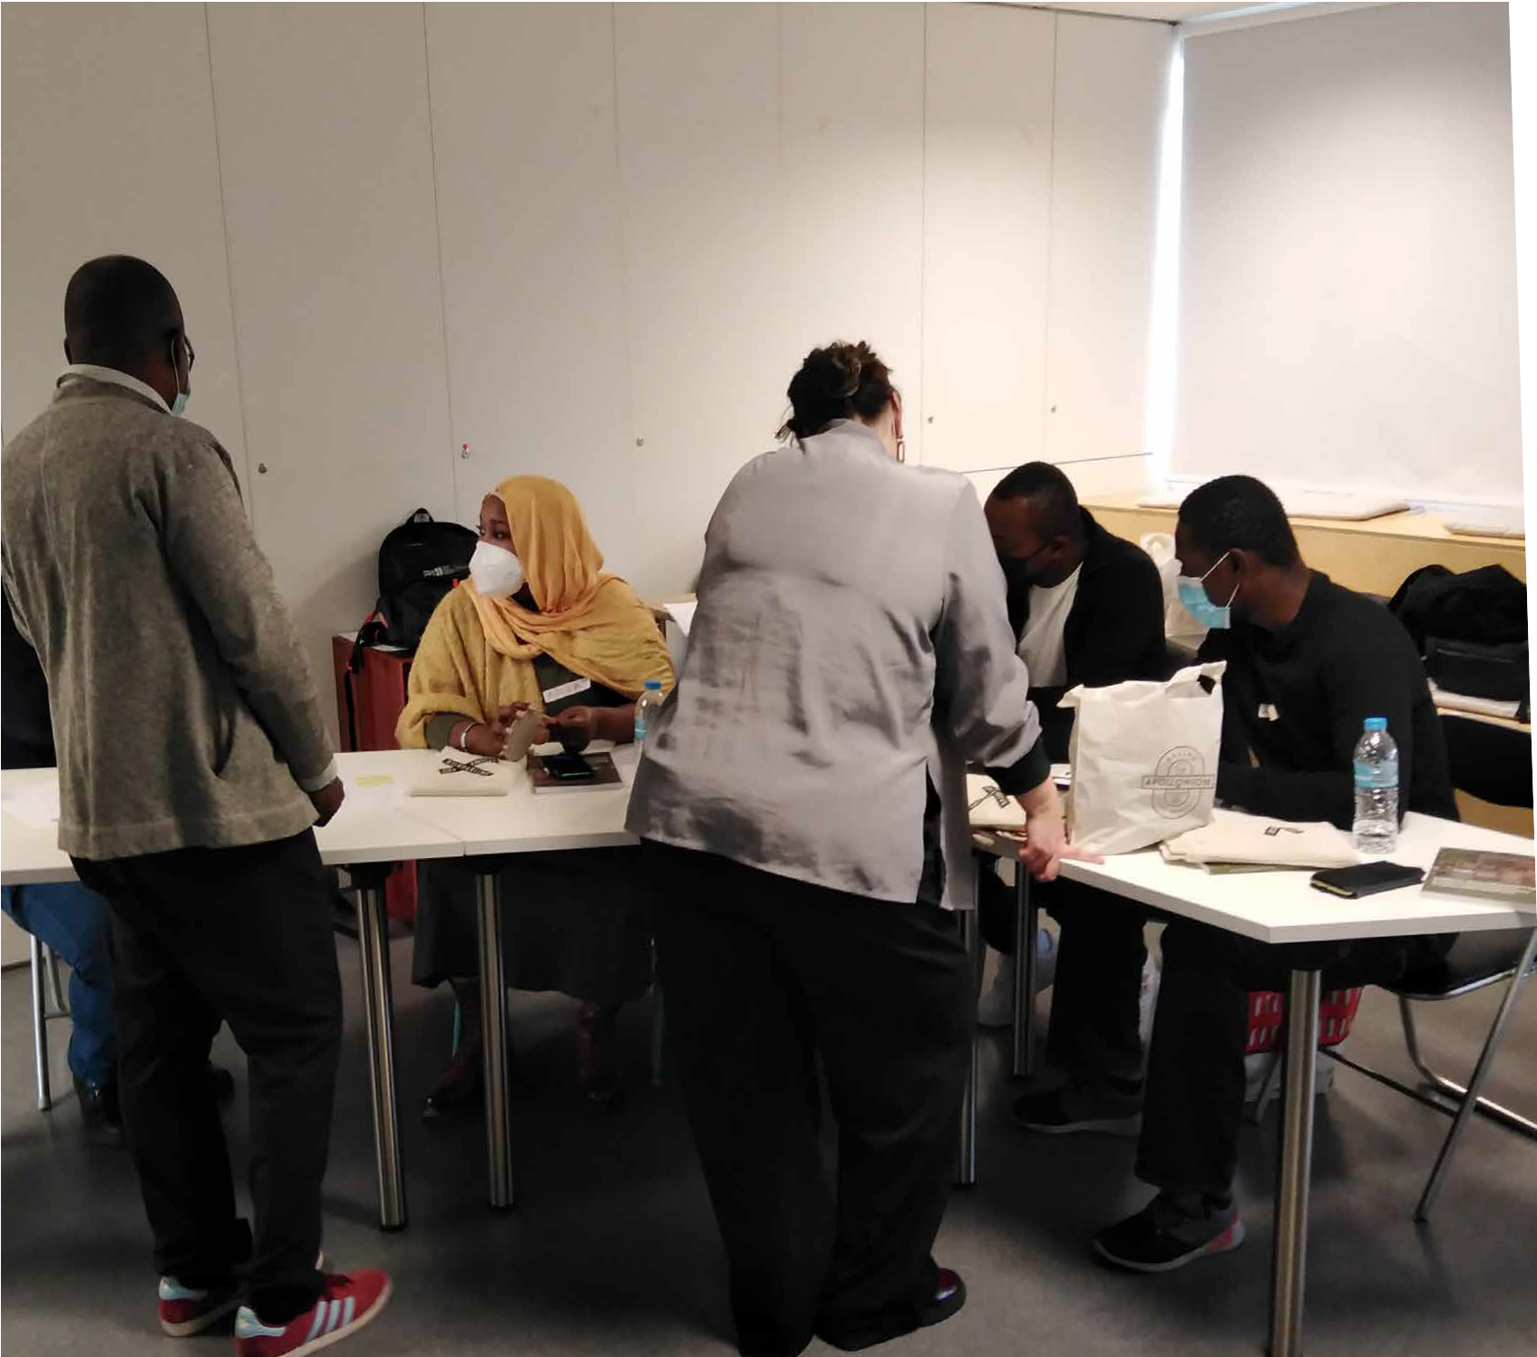
Step 2: Ensure that warm-up activities are related to the teaching con- tent and utilise them to determine what the learners already know by asking questions.
Step 3: Use at least one educational game activity during the session. These games act as a diagnostic tool for the teacher, are delightful for learners and trainers, and benefit intensive language learning.
Step 4: Do not hesitate to get along with topics beyond the L2 learners’ capacity since they are required at the workplace. Do not emphasise the details and expect a learners’ profound endorsement of the teaching material. Instead of looking into the complexity of a phenomenon, at- tempt to examine it in the workplace content (e. g. Instead of teaching the imperative, investigate the imperative form of the verbs used in the work environment context like Bring me the tool! or See toaster’s tem- perature, etc.).
Step 5: And remember to be fun! A fun learning approach positively im- pacts motivation while determining what we learn and how much we retain. Do not undervalue how much the students can teach the trainers!

Slide 23
References
Busch, B. (2012). The Linguistic Repertoire Revisited. Applied Linguistics,
33(5), 503–523. https://doi.org/10.1093/applin/ams056
Council of Europe. (2018). Reference Framework of Competences for Democratic Culture. Volume 1: Context, concepts and model. Strasbourg: Council of Europe. Retrieved from https://www.coe.int/en/web/ reference-framework-of-competences-for-democratic-culture/rfcdc- volumes
Council of Europe. (2018). Reference Framework of Competences for Democratic Culture. Volume 2: Descriptors of competences for democratic Culture. Strasbourg: Council of Europe. Retrieved from https://www. coe.int/en/web/reference-framework-of-competences-for-democratic- culture/rfcdc-volumes
Council of Europe. (2018). Reference Framework of Competences for Democratic Culture. Volume 3: Guidance for Implementation. Strasbourg: Council of Europe. Retrieved from https://www.coe.int/en/web/ reference-framework-of-competences-for-democratic-culture/rfcdc- volumes
Hadfield, J. (1998). Beginners’ Communication Games. Pearson Education Ltd.
International Labour Organization, Labour Administration and Inspection Programme LAB/ADMIN. (2010). Labour inspection in Europe: Undeclared work, migration, trafficking [Working Document Number 7]. Retrieved from

Slide 24
https://www.ilo.org/labadmin/info/pubs/WCMS_120319/lang--en/index. htm
Pekrun, R., Goetz, T., Titz, W., & Perry, R. P. (2002). Academic emotions in students’ self-regulated learning and achievement: A program of qualitative and quantitative research. Educational Psychologist, 37(2), 91–
105. https://doi.org/10.1207/S15326985EP3702_4
Pigni, A. (2014). Building resilience and preventing burnout among aid workers in Palestine: a personal account of mindfulness based staff care. Intervention 2014, 12(2), 231 – 239.
Reinders, H. & Darasawang, P. (2011). Diversity in Language Support. In: Stockwell, G. (Ed) Computer-assisted language learning: Diversity in research and practice. Cambridge: Cambridge University Press.
Shen J., Poppink S., Cui Y., & Fan G. (2007). Lesson planning: a practice of professional responsibility and development. Educational Horizons, 85(4), 248-260.
Tokatlı A. M & Keşli Y. (2009). Syllabus: how much does it contribute to the effective communication with the students? Procedia - Social and Behavioral Sciences 1(1), 1491-1494. https://doi.org/10.1016/j. sbspro.2009.01.263
Tzotzou, M, (2014). Designing and administering a needs analysis survey to primary school learners about EFL learning: A case study. Preschool & Primary Education 2014 2(1), 59-82. https://doi.org/10.12681/ ppej.62
Yeganehpour, P. (2017). Ice-breaking as A Useful Teaching Policy for Both Genders. Journal of Education and Practice, 8(22), 137-142.
Symbiosis, Guide to Job Oriented Linguistic Support for Migrants and Refugees, 2022, https://sps.symbiosis.org.gr/publications/guide-to-job-oriented-linguistic-support-for-migrants-and-refugees-lilali/,

