Slide 1
Introduction to Project Management
Introduction to Accounting
Further Reading Material
PROJECT MANAGEMENT
The project is co-funded by the European Unions‘ Asylum, Migration and Integration Fund. The content of this presentation represents the views of the EMVI project partnership only and is their sole responsibility. The European Commission does not accept any responsibility for use that may be made of the information it contains.

Slide 2
How do I develop a project?
What is a project?
Project Planning
Method for Training: The Problem Tree
Writing a Project Proposal

Slide 3
What is a project?
According to DIN 69900*, a project is defined as an undertaking that is essentially characterised by. . .
the uniqueness of the conditions in their entirety, a target,
limitations of time, money, personnel or other kinds,
limitations vis-à-vis other projects, and a project-specific organisation.
A Project has a beginning, a middle and an end. Within the framework of a project, it must be clear at the beginning where one wants to arrive at the end. The improvements as a result of a project should continue to exist even without the project (effects).
*German Institute for Standardisation (DIN)
Source: https://www.nord-sued-bruecken.de/foerderung/foerderprogramme/in-sdg.html

Slide 4
Project Planning (1)
A project application reflects the planning process and is guided by the following questions:
Applicant/project promoter
Situation analysis—Problem description
Target group(s)
Effects
Indicators
Project activities and achievements
Sustainability
Cost and financing/expenditure and income plan
Source: https://www.nord-sued-bruecken.de/foerderung/foerderprogramme/in-sdg.html

Slide 5
Project Planning (2)
Possible steps in the planning process
(based on the Logical Framework Approach)
1. Stakeholder analysis (for more see EMVI-Module Networking & Advocacy)
Identify individuals, groups, governmental and non-governmental institutions, companies, etc. that may be affected by the project.
The stakeholders are all related to the project—affected or involved, directly or indirectly, positively or negatively.
2. Problem analysis provides better insight into the existing situation and
the influence of the social environment on those involved;
is based on the knowledge and viewpoints of those involved;
is sometimes based on the creation of a problem tree, which has emerged during participatory workshops and captures and maps the respective priorities of the stakeholders.
A problem is a real, existing condition that is considered negative and requires change.
Source: https://www.nord-sued-bruecken.de/foerderung/foerderprogramme/in-sdg.html

Slide 6
Project Planning (3)
Problem Definition
In any case, a description of the present condition in which the target group lives is needed in order to be able to assess the future condition.
Example:
women and children are undernourished
incomes of the farming families are low
Migrants can not participate politically
What is the most typical mistake in problem formulation?
A common mistake in problem formulation is that the problem is expressed as a lack of a very specific solution, e.g.
shortage of milk powder and medicines
lack of fertilisers
Export of food cash crops instead of local/self-sufficient farming
Source: https://www.nord-sued-bruecken.de/foerderung/foerderprogramme/in-sdg.html

Slide 7
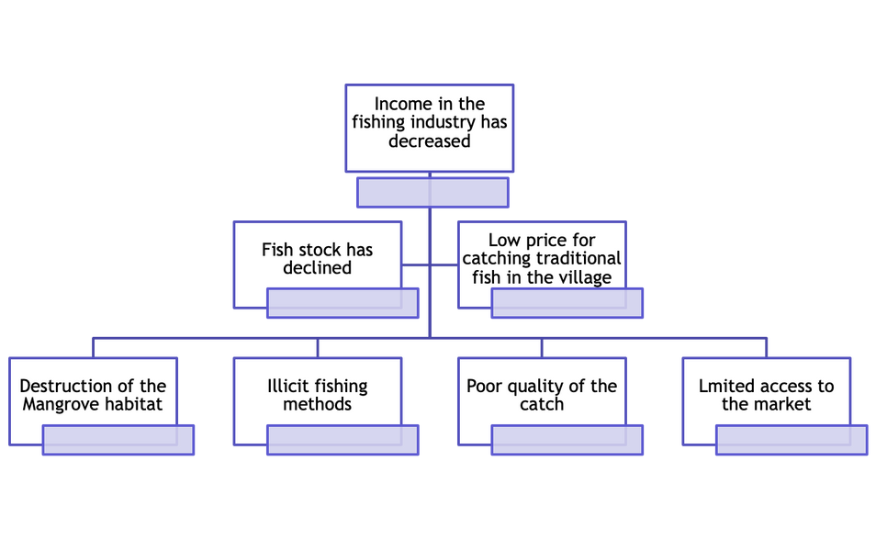
Project Planning (4)
The next crucial step will be to reveal interrelationships between the problems!
Example:
Effect
Cause
Source: https://www.nord-sued-bruecken.de/foerderung/foerderprogramme/in-sdg.html

Slide 8
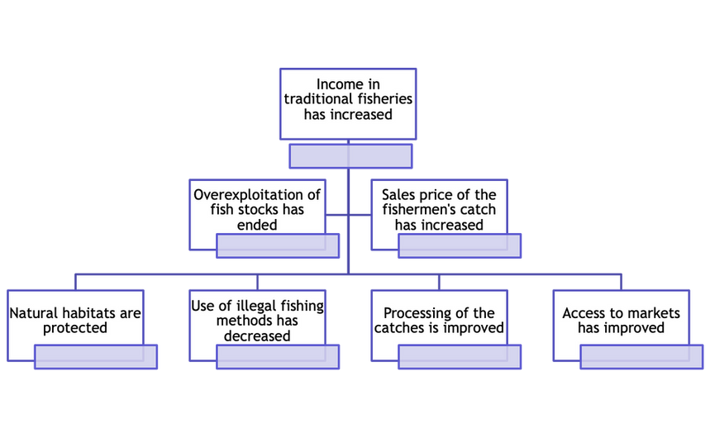
Project Planning (5)
Transforming the problem into positive achievements by establishing an end/means relationship
Aim/Goal
Means
Source: https://www.nord-sued-bruecken.de/foerderung/foerderprogramme/in-sdg.html

Slide 9
Project Planning (6)
Strategic Analysis
Aims at:
Analysing alternative solutions that could contribute to the achievement of the objective;
Evaluating the respective merits of the approaches;
Selecting the best strategy based on criteria. These are agreed upon by the representatives of the stakeholders directly involved.
Some possible criteria
The urgency of the situation
Relevance for the targeted group
Social aspects
Existing knowledge and possibilities (in regard to the targeted group)
Existing financial resources and expertise etc.
Complements other projects
Adds to present challenges or contributes to decreasing inequality (e.g. gender equality)
Relevant for partner countries, the EU or other international entities
Source: https://www.nord-sued-bruecken.de/foerderung/foerderprogramme/in-sdg.html

Slide 10
Project Planning (7)
Effect Analysis
Main goal= Indirect effect
Project goal = Direct Effect
Results = Achievements
Strategy for the control of fishermen's associations
Market orientation strategy
Source: https://www.nord-sued-bruecken.de/foerderung/foerderprogramme/in-sdg.html

Slide 11
Project Planning (8)
Definition of Effects:
Effects are changes in a state as a result of an intervention.
They can be endogenous and non-endogenous, expected or unexpected, positive or negative.
They occur from the first moment of the intervention, during the entire project duration and in very different areas
Effects are the result of social interactions
Source: https://www.nord-sued-bruecken.de/foerderung/foerderprogramme/in-sdg.html

Slide 12
Project Planning (9)
Definition of Indicators
Indicators must be SMART:
Specific: specific in terms of quality and quantity;
Measurable: measurable with reasonable effort;
Available: available from existing source;
Relevant: important for what they are supposed to measure and in relation to the level of the project logic (type of indicator);
Timely: timely, useful in a reasonable time for project management.
Indicators
...are parameters that have been selected to illustrate a specific, often not directly measurable and complex issue
...say what a change can be observed or measured by (yardsticks)
Quantitative indicators with a performance value:
XY percent of those trained have found a job
Qualitative indicators with a performance value:
XY say they have found a better job
What information does an indicator contain?
Subject reference: Who? (e.g. target group)
Spatial reference: Where? (e.g. region)
Time reference: When/how long?
Quantity: How much/how many?
Quality: How good/which criterion is changing?
Example of an indicator:
100 small producers and 50 female producers in Mzuzu have increased the production of banana flour by 25% per year, achieving export quality from the 2nd year of production.
Source: https://www.nord-sued-bruecken.de/foerderung/foerderprogramme/in-sdg.html

Slide 13
Project Planning (10)
4 ways to develop indicators:
1. measure or count: (exact numbers)
Example: weigh people, give weight in kg
2. scale: (gradable description)
Example: scale the frequency of diseases: always - often - sometimes - rarely - never
3. classify: (non-gradable characteristics)
Example: YES or NO: "Is your child sick today?"
Example: WOMAN or MAN: "Is the counselling centre run by a woman or a man?"
4. describe qualitatively: (exemplary description in words only)
Example: simply describe in words what is important in the context of this indicator: "A group of women from neighbourhood X in M. have started baking doughnuts from soy flour to sell in neighbourhood Y".
Source: https://www.nord-sued-bruecken.de/foerderung/foerderprogramme/in-sdg.html

Slide 14
Project Planning (11)
Expenditure and Income plan
all expenses incurred for the project must be reflected in the expenditure and income plan
when applying for public funds, maximum limits must be observed (Federal Travel Expenses Act, BAköV scale of fees, prohibition of betterment, request for proposal...this needs to be nationally adopted!)
Activities/Achievements
All activities that must be carried out in order to achieve the project impact, i.e. the:
organisational, content-related and methodological conception and design (e.g.: program schedule, speakers, main topics, questions, discussion points, methodological approach, pedagogical concept, background, special features, etc.).
Cooperation and networking partners (who is involved in the implementation of the project activities and in what form should this take place?)
If it is not yet possible to make a statement on certain aspects, specify and explain further planning/decision-making.
Financing plan/income plan
shows who finances what (applicant's own share, other donors/third-party funds, organisation to which funding is applied for).
If several donors are funding a project → equal cost and financing plans.
Use donor CoFi forms → donor harmonisation
Source: https://www.nord-sued-bruecken.de/foerderung/foerderprogramme/in-sdg.html

Slide 15
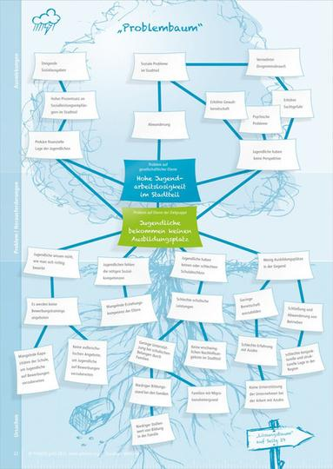
Method for Problem Analysis: The Tree of Problems
A useful tool for analysing a problem with all its causes, effects and factors visualised in the problem tree. The problem tree results from the data you collected during the needs and context analysis.
Branches = Effects
3-30 People (group work)
Roots = Problems
20-4per working group Evaluation approx. 10 minutes 0 minutes
Group work approx. 15-20 minutes
Presentation approx. 5 minutes
Introducing a tool for the problem and goal analysis
Flipchart paper or other large paper (A2) for group work, wide pens, tape/pens or pin board with pins.
Description of the method:
Ask the question:
What problem are you facing in your project?
Let the participants choose a problem in small groups (max. 5 persons per group) and ask them to analyse it using the problem tree method. After creating a problem tree, this method can be used to create a goal tree.
Source: https://www.wirkung-lernen.de/wirkung-planen/bedarfsanalyse/problembaum/

Slide 16
Method: Evaluation of Indicators
Description:
Please formulate 2-3 impact objectives and indicators for your project.
Answer the following questions:
- Who are our target groups?
- What problem do we want to solve for the target group? What
do we want to change in the target group?
- What difference do we make with our work?
- Check: To what extent is your project goal SMART?
3-30 People (group work)
20-40 minutes
Group work approx. 15-20 minutes Presentation approx. 5 minutes per working group,
Evaluation approx. 10 minutes
Introducing a tool for
the problem and goal analysis
The indicators must be: SMART!
Specific: specific in terms of quality and quantity;
Measurable: measurable with reasonable effort;
Availabl : available from existing source;
Relevant: important for what they are supposed to measure and in relation to the level of the project logic (type of indicator);
Timely: timely, useful for project management in a reasonable amount of time.
Flipchart paper or other large paper (A2) for group work, wide pens, tape/pens or pin board with pins.
Source: https://www.nord-sued-bruecken.de/foerderung/foerderprogramme/in-sdg.html, Method: Verbandsakademie für Migrant:innenorganisationen (VAMOs) IMAP GmbH

Slide 17
How do I write a project proposal?
What is important to know?
Dos and Don'ts
Further Reading Material

Slide 18
A good project proposal is a prerequisite for the approval of a project. However, a good project proposal does not guarantee a good project.
Requirements for a good project proposal:
Funding requirements are met
Submitted on time
Complete application (current forms used?)
All questions have been answered
Guidelines have been followed
The Application is clear, concise and comprehensible
The Application is based on facts
The Application logic is respected (e.g.: no description of project activities when it is about problem analysis)
Cost plan reflects project activities
In the end, it does not depend on a good project proposal and the words used in it. If the project development is well thought out, the proposal will unfold by itself...
Does a good project proposal equal a good project?
Source: https://www.nord-sued-bruecken.de/foerderung/foerderprogramme/in-sdg.html

Slide 19
Dos and Don’ts in the writing of a project proposal
Do
Don't
...include essential contents, methods and didactic concepts or include them as examples. Do so even if things are not always fixed and can change.
...follow the "logical" structure of an application, without "telling" and repeating the project idea. Be careful not to write about objectives and methods in the problem analysis part.
...follow the structure and do not describe the measures in epic breadth when describing the targeted group!
...Focus on the project goal but do not make the mistake of describing too many and very different goals that are unrealistic!
...assume that donors or people who decide on projects know the association, the work and the concrete projects. Remember to describe your organisation and the project in a comprehensible way.
...put items, products or entire activities in the cost plan that are not even described or mentioned in the application. Especially with the sometimes quite useful documentation of the project, it is assumed that this does not need to be explained further
Source: https://www.nord-sued-bruecken.de/foerderung/foerderprogramme/in-sdg.html

Slide 20
Project Management
What makes a project a good project?
Project Cycle Management (PCM)
Aspects of Documentation and Accounting

Slide 21
Project Management
Project
One-off process
Complex structure
Defined goals
Fixed deadline
Limited costs
Management
Planning
Management
Organisation
Control
Planning
Evaluation
Monitoring
Source: https://www.nord-sued-bruecken.de/foerderung/foerderprogramme/in-sdg.html

Slide 22
A good project: content criteria - project implementation
Transparency of funding flows and project planning
Monitoring and accompanying evaluation
Compliance with procurement rules
Personnel: recruitment/payment/gender/respect for workers' rights
Flexibility: adapting project strategy if conditions change
Evaluation
Content criteria - Evaluation
Internal evaluation
External evaluation
Analysis of the evaluation results
Lessons learned
The Basis for further projects
Source: https://www.nord-sued-bruecken.de/foerderung/foerderprogramme/in-sdg.html

Slide 23
A good project must be good at every stage of the project cycle
Project Cycle Management (PCM)
Program
Evaluation
Identification
Implementation
Formation
Source: https://www.nord-sued-bruecken.de/foerderung/foerderprogramme/in-sdg.html
Funding/Financing

Slide 24
Meaningful and successful project management...
.... consists of three phases/components: planning, implementation and evaluation;
.... sees planning as a participatory process of shared understanding and agreement;
....focuses equally on impact and process;
.... consists of defined phases;
....is open in terms of methods and tools; and
....includes cyclical feedback loops throughout the process.
Source: https://www.nord-sued-bruecken.de/foerderung/foerderprogramme/in-sdg.html

Slide 25
Cost items
Cost plan: contains all costs including administrative costs
The cost plan should reflect the measures applied for
explain larger cost items in the application text
Composition/amount of costs should be recognisable (if possible defined in units (e.g. 10 teaching units 90 min. á 100 € = 1.000,00 €)
Source: https://www.nord-sued-bruecken.de/foerderung/foerderprogramme/in-sdg.html

Slide 26
Accounting
Should be considered from the beginning!
Consists of content and financial accounting
Source: https://www.nord-sued-bruecken.de/foerderung/foerderprogramme/in-sdg.html

Slide 27
Case Report
A case report should entail:
1. Situation description/problem description
2. Target groups
3. Effects/project objectives
4. Indicators (qualitative and quantitative)
5. Description and explanation of project activities
6. Cross-cutting issues
7. Sustainability
8. Cost and financing plan
9. Final evaluation (conclusion, consequences)
Source: https://www.nord-sued-bruecken.de/foerderung/foerderprogramme/in-sdg.html

Slide 28
Everything went well. The measure was successfully implemented, and the participants were satisfied, everything worked out in terms of organisation.
This is not a sufficiant case report!
Source: https://www.nord-sued-bruecken.de/foerderung/foerderprogramme/in-sdg.html

Slide 29
Financial Report
Simple/complete proof of use
Consists of voucher list, cost plan, financing plan (detailed overview of all expenses and income of the project).
Accounting by project/cost centre (personnel costs, fees, travel costs, accommodation/food, material costs, administrative costs)
No payment without receipt
Observe time limits (budget year)
Check donors for economic efficiency, proportionality and plausibility
Source: https://www.nord-sued-bruecken.de/foerderung/foerderprogramme/in-sdg.html

Slide 30
Target/Actual Comparison of Costs
Last confirmed cost and financing plan in debit
with reduced project costs:
Administrative costs decrease in percentage terms
Funding amount decreases in percentage
Enclose receipts (depending on the funding agency) - Reconciliation/reference to receipts in the progress report
Cost estimates must be available upon request (public procurement law: from 500 €-1,000 €, comprehensible price calculation with three companies, from 1,000 €, three written offers) (Example Germany).
Include country and regional specifics for cost comparison etc.
Source: https://www.nord-sued-bruecken.de/foerderung/foerderprogramme/in-sdg.html

Slide 31
Receipt list
Grouped by cost items (cost centres)
Sorted by payment date
Transfer totals of cost items to target/actual comparison
Attach receipts (if possible in the same order) (for complete VN)
Document fees with invoices/fee contract
Proof of payment must go with the receipt
Source: https://www.nord-sued-bruecken.de/foerderung/foerderprogramme/in-sdg.html

Slide 32
More Tips
Charged costs must reflect the content of the project.
Check whether all costs are eligible (travel expenses abroad)
Verifiable fee scales must be taken into account (BAköV rates).
Justify deviations of >20% and apply for reclassification/approval with financial statement
Adjust Cofinancing in time if third-party funds are not approved
Totals of cost and financing plan must match
Settle accounts on time or apply for extension in time
Source: https://www.nord-sued-bruecken.de/foerderung/foerderprogramme/in-sdg.html

Slide 33
Staff Costs
Remember:
Collective Bargaining Agreements
Minimum wages
Salary directives
Include country and regional specifics for cost comparison etc.
Source: https://www.nord-sued-bruecken.de/foerderung/foerderprogramme/in-sdg.html

Slide 34
Professional Fees
Freelance services (e.g. by educational speakers, writers, scientists, artists, web designers, etc.).
Basis fee contract (service rendered, exact topic, place and period).
Invoice (invoice number, description of activity, subject, place, period) or reference to the fee contract, tax number or VAT identification number, indication of VAT or reference to VAT exemption.
Observe fee scales (German BAköV)
No valorised services (depending on the donor)
Include country and regional specifics for cost comparison etc.
Source: https://www.nord-sued-bruecken.de/foerderung/foerderprogramme/in-sdg.html

Slide 35
Administrative Costs
- In case of higher costs → obtain cost estimates (public procurement law).
- Cost estimates (from 500 €-1,000 € comprehensible price determination with three companies, from 1,000 € three written offers).
- No "general" equipment such as cupboard, projector, PC (this can be mentioned in the project measures), but actually required things such as
Accommodation/meals per participant in a specific event/project step
This are country specifics of Germany as an example, replace them with your country and regional specifics
Source: https://www.nord-sued-bruecken.de/foerderung/foerderprogramme/in-sdg.html

Slide 36
Equality Capital
All funds available to the NGO (not earmarked for projects approved by other donors). (!) project-related donations are regarded as external funds by individual donors)
Donations, sponsorship income, reserves from association assets
Revenues from the implementation of the project generally to be used to finance the project, e.g. entrance fees, sales proceeds, participant contributions
Source: https://www.nord-sued-bruecken.de/foerderung/foerderprogramme/in-sdg.html

Slide 37
Valorised Services
Valorisation of services = valorisation of labour services without real cash flow
show the value of voluntary work contributions from third parties free of charge (e.g. infrastructure such as technical equipment, meeting rooms and/or e.g. accommodation and catering)
Can sometimes be counted as own resources (see funding guidelines for each country/budget line)
Source: https://www.nord-sued-bruecken.de/foerderung/foerderprogramme/in-sdg.html

Slide 38
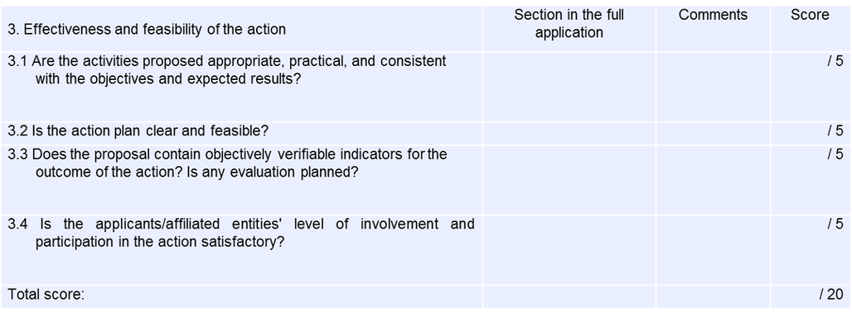
Decision-making processes of donors (example EU)
Own contribution
Own resources + income + (valorised services) = own contribution
often at least 10% of total costs, some donors recognise third-party funds as own funds
Third-party funds Grants from other donors (foundations, other public and private institutions)
Source: https://www.nord-sued-bruecken.de/foerderung/foerderprogramme/in-sdg.html

