Slide 1
Strategic CoMMUNICATION
Reporting and communicating by migrants on migrants’ issues
The project is co-funded by the European Unions‘ Asylum, Migration and Integration Fund. The content of this presentation represents the views of the EMVI project partnership only and is their sole responsibility. The European Commission does not accept any responsibility for use that may be made of the information it contains.

Slide 2
What is news?
Is it new?
Is it unusual?
Is it interesting or significant?
Is it about people?
These elements make up what we call the "news value" of information. The stronger the elements are, the higher the news value.

Slide 3
You should be objective and impartial
Be fair in your:
- selection of news
- choice of sources and interviewing technique
- news writing
- use of the story
Avoid open displays of support for one side in a conflict

Slide 4
The News story & THE INVERTED PYRAMID

Slide 5
Know your audience
Do not make false assumptions about your readers or listeners.
Do not generalise from your own personality and narrow group of friends and relatives and assume that your readers or listeners are "like us".

Slide 6
Who is your audience (which migrant Community/IES)
How big is the community?
Where do they live?
What languages do they speak?
Are they mainly of one or two age groups?
Are they mainly male or female?
How educated are they?
What kind of educational background do they have?. Should you use simple language? How long will they pay attention to an article or a programme?
What are their socio-economic backgrounds?

Slide 7
what INFO do they want?
World news
National news
News on integration
News on participation in civic and political life
News about the community itself
News about other groups/communities
News from special countries overseas

Slide 8
Sensitivity & Accuracy
Sensitivity
Be very sensitive when reporting. Very often, migrants’ place in mainstream society is unsure. This does not mean that you should ignore the existence of tensions, simply that you should not make them worse by your communication.
Accuracy
When reporting on migrants from the outside of each and every community, you must still maintain a high level of accuracy.

Slide 10
Fake News & Trust Chains
a made-up, untrue story or invented “fact” that has been written or presented to seem genuine
or
an accusation that a genuine news story or actual fact is false, in order to undermine it.

Slide 11
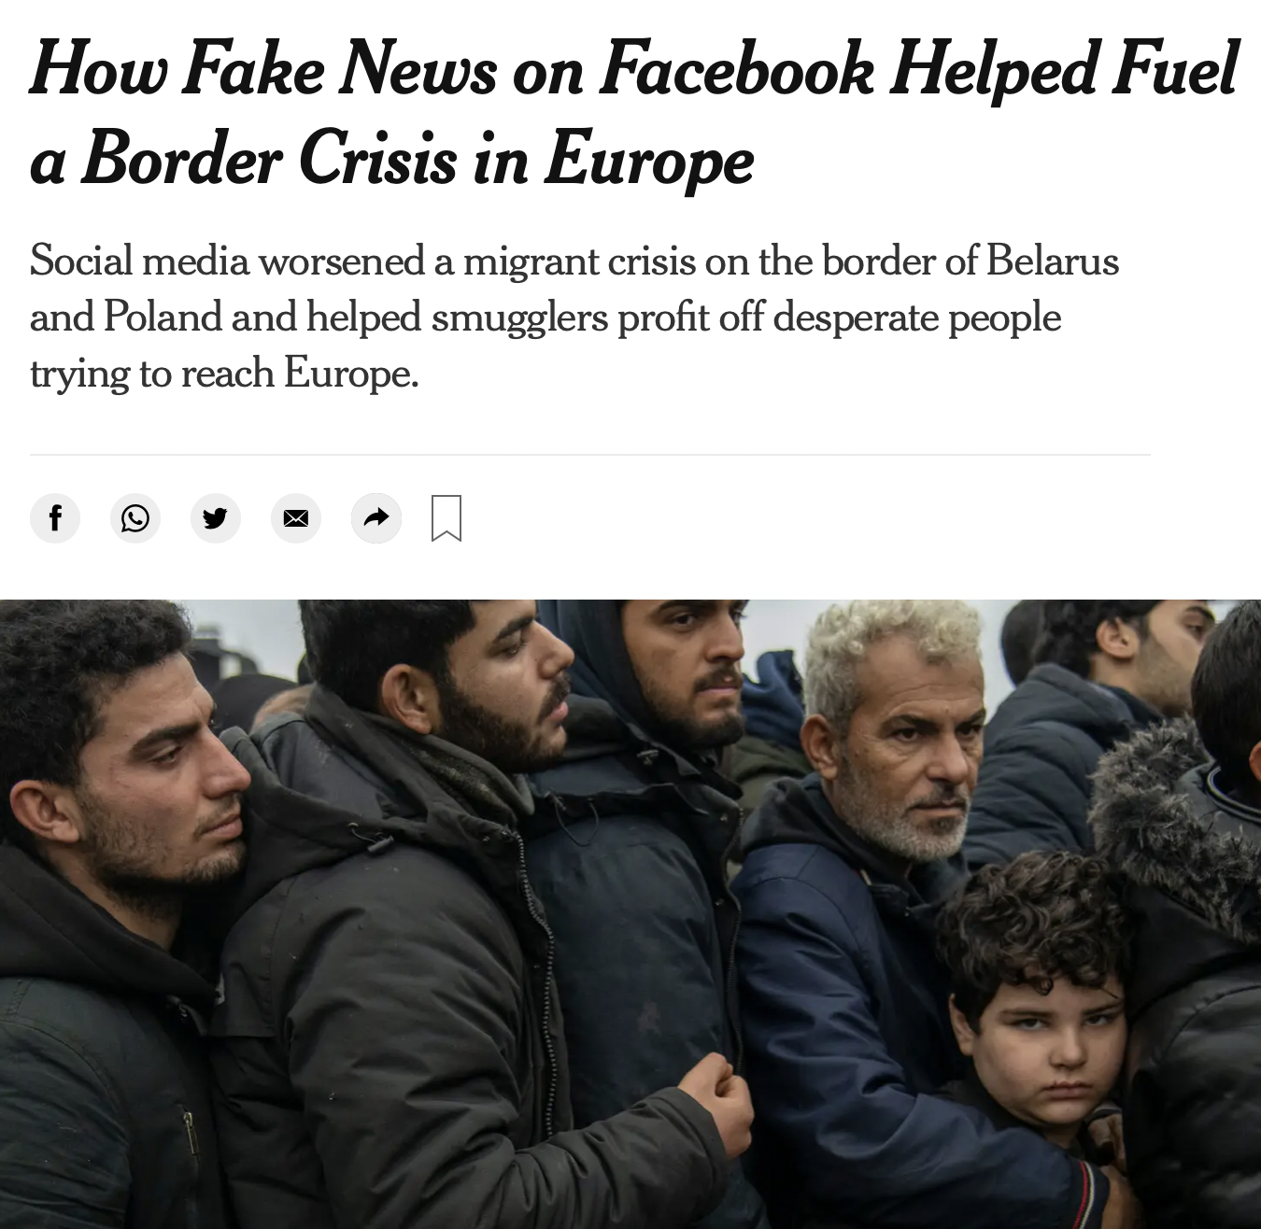
Different kinds of fake news
Genuine errors
News that is wrong because of mistakes, genuine misunderstanding or because the person generating the news or passing it on is not really good at it. This type of “fake news” has always existed and we generally forgive those responsible as “only human”.
Satire News presented as satire – or satire presented as news. This is made-up news printed or broadcast in such a way that it is obvious to readers and viewers that it is not true, just a joke
Half-truths There is the kind of disinformation that takes real, provable facts and twists them, usually by selectively quoting some parts but not others.
Manufactured news The most harmful kind of “fake news” is made up or manufactured in order to deceive. Repeated often and long enough, this maliciously manufactured “fake news” not only damages the kind of rational discussion necessary for the functioning of democracy, but it leaves everybody, locals and migrants, readers, listeners and viewers wondering just what they can believe, if anything at all.
Image credit: New York Times

Slide 12
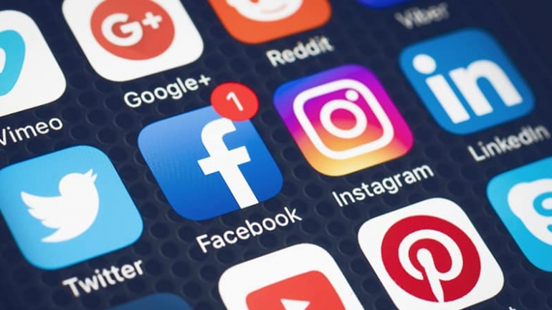
Social media and fake news
Very important for migrant communities!
Facebook, Instagram, Twitter and SnapChat are far less trusted than traditional print and broadcasting.
Social media connect families and friends, warning of danger so fast even the emergency services use them. They are generally beneficial and here to stay.
But social media are not so good in the production and transmission of news.
The very things that make social media so popular also make them so dangerous in spreading fake news. Anybody can use them, they are instant and there are few controls over content or quality standards.
Social media play a major role in the “amplification” of false news.

Slide 13
INTERACTIVE EXERCISE: the Lose/Gain Test
What have MIGRANTS got to gain by saying A SPECIFIC SOURCE OF INFORMATION?
What have they got to lose?

Slide 14
MIGRANTS REPORTING ON MIGRANTS ISSUES

Slide 15
Interviewing SKILLS
Speaking and Listening - An interview is just a conversation
Making Friends - Everybody talks more freely when they are relaxed
Visualising - Can you now visualise the whole story?
Could you answer any question about this story if it was put to you - Who? What? Where? When? and especially Why? and How?
Evaluating - Ask yourself what is the significance of what you are hearing? Is it a big news story or a small one? Will it make an impact?
Recording – Don’t forget to press that button & Put your phone in Flight Mode!

Slide 16
Keep It Short and Simple when Presenting!
Avoid unfamiliar words
Repeat important words
Keep punctuation simple
Simplify numbers
Avoid abbreviations
Do not use quotes on radio or in television scripts

Slide 17
Basic Principles of Social Media
Social media platforms continue to emerge as essential newsgathering tools. These mediums offer exciting opportunities for reporters to collect information and for news organizations to expand the reach of their content, but they also carry challenges and risks.
Which are platforms do we use?
Why do we use them?
Who uses which platform?
Does it make a difference which social media platform you should use and for what?

Slide 18
HOW Can MIGRANTS USE SOCIAL MEDIA?
To find stories
To monitor developments in breaking news stories as they happen
As a reporting tool to find eyewitnesses, sources and images
To engage readers or viewers through continuous news updates
To promote content both pre- and post-publication
To develop an on-going relationship with their audience

Slide 19
Which Platform for What?

Slide 20
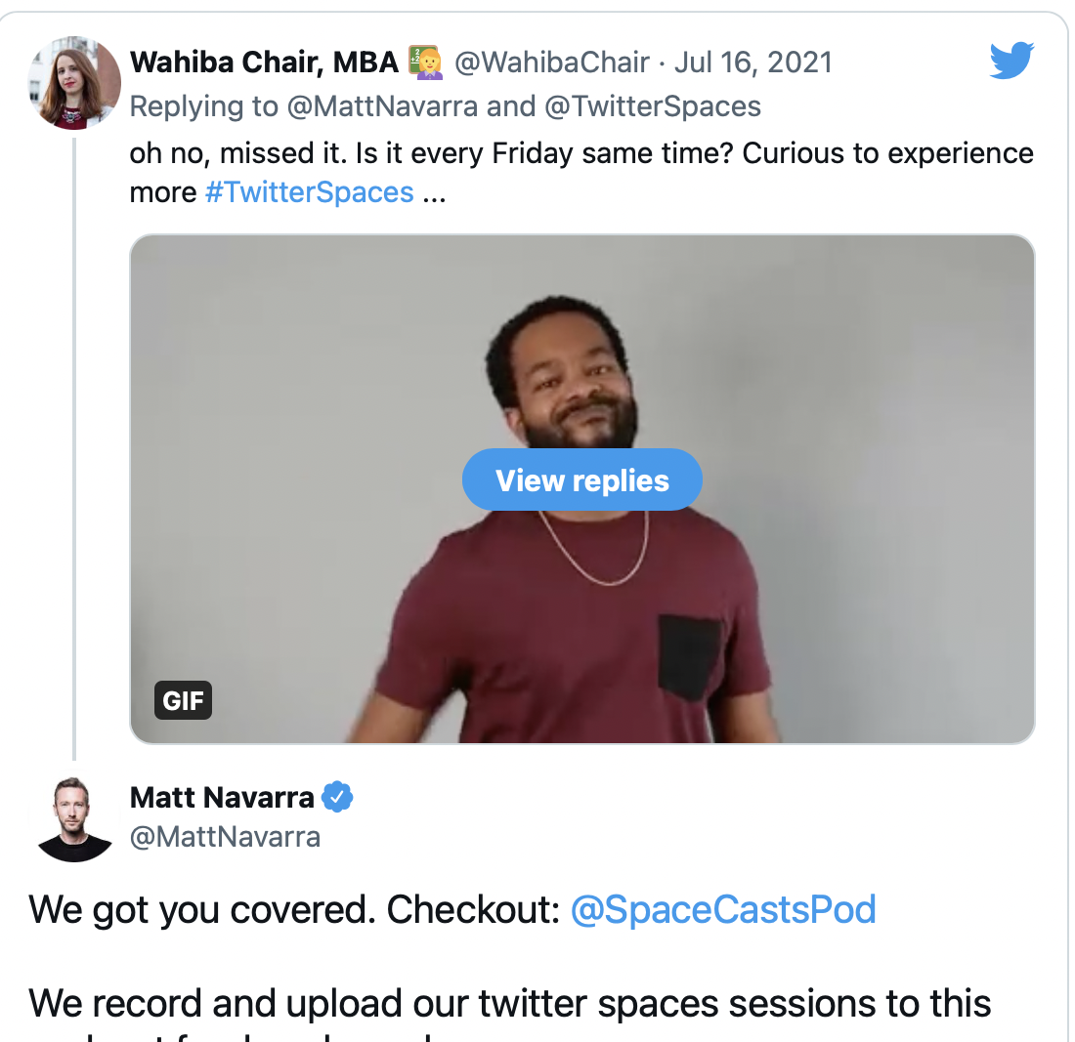
1. Social audio platforms and formats
Examples: Clubhouse, Twitter Spaces, Spotify
Used for: Listening to live conversations on specific topics.
How you can use them: New social audio platforms (like Clubhouse) and formats (like Twitter Spaces) have thrived during COVID-19 lockdowns while people have been at home with more time to join live conversations.
Advantage of audio social media platforms and formats is the high attention and engagement you’re likely to get from opt-in listeners. Lively, engaging conversations can help you build your image as a leader in your niche and introduce your business or products to valuable audiences already interested in topics related to your niche (otherwise, they wouldn’t be tuning in).
Here are some thought starters for using audio social media platforms:
Host industry panels.
Broadcast news and big announcements.
Host interactive sessions (such as AMAs) with your audience.
Record interviews during a live Clubhouse/Twitter Spaces chat and upload them as a podcast (example: The Social Media Geekout show).
Build your business’ thought leadership through a 30-60 minute show.

Slide 21
MAKE YOUR OWN STORY !
10 min exercise where:
Each migrants’ organisation produces a news item on its activities
2. Individual migrants interview each other
3 Individual migrants make a story on their integration experience

