Slide 1
Training Module: Diversity Dimensions and Anti-Discrimination
Dieses Veranstaltung wurde durch den Asyl-, Migrations- und Integrationsfond (AMIF) der Europäischen Union mitfinanziert. Der Inhalt gibt ausschließlich die Meinung der EMV-LII-Projektpartnerschaft wieder und liegt in deren alleiniger Verantwortung. Die Europäische Kommission übernimmt keine Verantwortung für die Verwendung der darin enthaltenen Informationen.

Slide 2
Introduction and Check-In
Hi, my name is …..
When it comes to diversity, I am particularly interested in …..
When you finished this training, what would you like to take with you?

Slide 3
Agenda
Diversity Dimensions and Basic Concepts
What is Discrimination?
Promoting Equal Opportunities and Non-Discrimination
Exercises
Dieses Veranstaltung wurde durch den Asyl-, Migrations- und Integrationsfond (AMIF) der Europäischen Union mitfinanziert. Der Inhalt gibt ausschließlich die Meinung der EMV-LII-Projektpartnerschaft wieder und liegt in deren alleiniger Verantwortung. Die Europäische Kommission übernimmt keine Verantwortung für die Verwendung der darin enthaltenen Informationen.

Slide 4
1. Layers and Dimensions of Diversity
There are three layers of diversity:
Primary Layer
Demographic diversity: Characteristics such as gender, ethnicity, etc.
Secondary Layer
Experiential diversity: Life experiences such as hobbies, affinities, etc.
Tertiary Layer
Cognitive Diversity: Our method of problem-solving and our perspective on the world.
Depending on the context, this layer can be defined differently (e.g. in an organizational context)
Source: https://www.cultureally.com/blog/dimensionsofdiversity

Slide 5
1. Layers and Dimensions of Diversity
The core-dimentions of diversity (secondary layer of diversity):
Age
Sexual orientation
Religion
Ability
Gender and sexual identity
Ethnicity and nationality
Social background
Source: https://www.charta-der-vielfalt.de/fuer-organisationen/vielfaltsdimensionen/

Slide 6
Example: Layers and Dimensions of Diversity in an Organisation
Organisational-Layer
Function
Secondary-Layer
Management Status
Geographic Location
Field of Work
Marital Status
Income
Core-Dimensions
Age
Social Background
Ethnicity and nationality
Parental Status
Personal Habits
Sexual Orienta-tion
Personality
Gender and sexual identity
Place of Work
Department/ Team
Religion
Physical and mental abilities
Recreational Habits
Appearance
Education
Work Experience
Union Affiliation
Duration of Employment
Source: https://www.charta-der-vielfalt.de/fuer-organisationen/vielfaltsdimensionen/

Slide 7
Important Concepts Regarding Diversity and Anti-Discrimination
Categorisation
Psychological processes that help us to understand and cope with the world that surrounds us.
Example: when we see a photo of a street and in the background, you can see the Eiffel Tower – we will probably assume that this photo was taken in Paris.
Categorisations aren’t always correct, for instance, people with breasts are not always women.
Stereotype
A simplified, generalizing attribution about a group of people.
Can be a judgement of behavior, habits, abilities or expectations towards others.
These attributions disregard individual differences and are applied to all members of a group.
Prejudice
Judgments that are made in advance in relation to a person or group of persons.
The action or behavior of a person is interpreted und judged within the filter of a stereotype.
Privilege
Usually not visible to those who have them: those who have privileges often benefit from them unconsciously.
Examples of privileges: being considered competent, being able to be in public without fear, being rude without running the risk of being reduced to a ‘culture’ or ‘mentality’, holding hands in public, etc.
We as individuals cannot ‘ withdraw’ from discrimination or our own privilege.

Slide 8
2. What is Discrimination? (I)
Discrimination is based on the processes we have already discussed: categorisation, stereotyping and prejudice.
In the context of these attributions, discriminatory social structures and violent practices emerge that reproduce structural inequality.
Discrimination takes place within a social framework, both consciously and intentionally as well as unconsciously and unintentionally.
Discrimination occurs when people or groups are treated differently or unfairly because of their perceived belonging to a certain group.
Discrimination can be recognised through questions such as ‘Who can (not) live where?’, ‘Who earns how much for which activities?’ etc.
Forms of conscious and unconscious discrimination are often mixed, for example in forgetting, ignoring and not thinking about needs that differ from one's own.

Slide 9
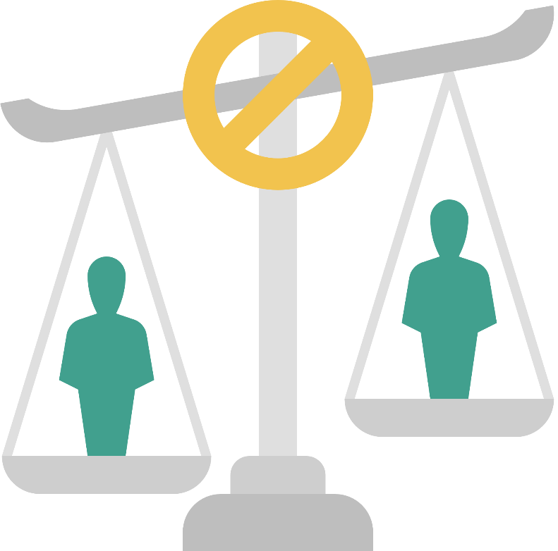
2. What is Discrimination? (II)
In Germany, discrimination on the basis of a characteristic ‘worthy of protection’ is prohibited.
These ‘characteristics worthy of protection’ are also called discrimination categories and represent characteristics on the basis of which people are discriminated against.
The discrimination categories are:
Religion and belief
Gender,
Disability and chronic illness
Ethnic origin
Age

Slide 10
2. What is Discrimination? (III)
Discrimination is closely linked to social power relations.
Legal, institutional, political, economic and cultural/symbolic power is needed to be able to discriminate.
Social Power Relations
Racism
Sexism
Heterosexism (against lesbians, gays, trans people)
Ableism
Social Status
Intersectional discrimination
Form, action,
Impact:
Discrimination
Source: Marcus Osei & Hartmut Reiners, ARIC-NRW e.V., Training series on anti-discrimination work for Bunsverband Bundesverband Netzwerke von Migrant*innenorganisationen (NeMO)

Slide 11
2. What is Discrimination (IV)
Levels of discrimination:
Individual/everyday life:
Attitudes, feelings and prejudices lead to discriminatory statements or actions on a personal level between individuals.
Institutional:
Institutionalised processes and structural barriers, which are often invisible, lead to disadvantage.
Structural:
Inequalities generated by the social system with its norms and its political and economic structures have an impact on organisations, which can lead to entrenched habits, established action patterns.
Discursive:
Discriminations created by social values and norm propositions, the thinking and talking about "us" and the "others" in science, literature, the media, politics or in private circles.
Source: Marcus Osei & Hartmut Reiners, ARIC-NRW e.V., Training series on anti-discrimination work for Bunsverband Bundesverband Netzwerke von Migrant*innenorganisationen (NeMO)

Slide 12
2. What is Discrimination (V)
Kimberlé Crenshaw, is the leading professor of Law at UCLA and Columbia Law School & executive director of the African American Policy Forum. She explains intersectionality in this video: https://www.youtube.com/watch?v=xh2Z4XoCPLU
Intersectional Discrimination:
...looks at how actual or assumed identity markers or affiliations intertwine to form unique forms of discrimination.
Analysing discrimination only one-dimensionally overlooks the experiences of those who face the compounding of discriminatory grounds.
Further Reading:
Kimberlé Crenshaw,
https://www.oxfordpublicphilosophy.com/philosophers-racialised-as-black/kimberl-w-crenshaw
Factsheet - Race in Germany and Europe, Center for Intersectional Justice e.V.:
https://drive.google.com/file/d/1LR1q6XX5AAjGFF4BU2Ks-MKcct46UKS0/view
Source: Marcus Osei & Hartmut Reiners, ARIC-NRW e.V., Training series on anti-discrimination work for Bunsverband Bundesverband Netzwerke von Migrant*innenorganisationen (NeMO)

Slide 13
3. Promoting Equal Opportunities and Non-Discrimination in an Organisation
The involvement of all persons affected by the measures to promote equal opportunities and non-discrimination in your organisation is crucial.
4 steps to reduce discrimination in the workplace and promote equal opportunities:
Understand discrimination.
Revise processes in such a way that disadvantages and the influence of (unconscious) prejudices are reduced.
Review internal regulations, guidelines etc. for discriminatory aspects and revise them in order to reduce discrimination.
Support and protect employees and clients.

Slide 14
Recommendations for Discrimination-Critical Organisational Development
Create transparency about decision-making processes.
Acquire diversity and anti-discrimination knowledge.
Address resistances.
Never work alone and start with people who are motivated
Don't give up when things aren't going so as planned.
Enable participation.
Get feedback on the developed documents and strategies.
Get external support.
Source: BQN Berlin e.V.: unSichtbar machen, Verwaltungsstrukturen machtkritisch verändern, Berlin, 2022, p. 37 f.

Slide 15
Principles for the implementation of a diversity concept
Equal treatment
Different needs are taken into account on a basis of equality.
Equal opportunities
Barriers, for example regarding promotion, access to further training, etc. are reduced.
Valorisation of diversity
Different talents and strengths are recognised and perceived as promoting a mutual learning process.
Optimal utilisation of the comparative advantages of diversity
The various aspectsof diversity are recognised recognised as equilibrating factors.
Resource orientation
Skills such as language skills or knowledge of two different environments acquired through migration are recognised and used as a resource.
Non-discrimination
Incidents of discrimination are openly addressed and sanctioned, structures are adapted, discriminatory regulations are eliminated.
Source: Catherine Moser, Myriam Kleiner: Diversität fördern, rassistischer Diskriminierung vorbeugen, Bern, 2011, p. 22.

Slide 16
4. Exercises
For group work and self learning

Slide 17
Exercise 1: Questions to Reflect Upon
1 + plenary
Examining your own positioning
Reflection of privileges
Description of the method:
Take 30 min. to reflect on the questions.
If doing this exercise in a group: Discuss your reflection with the group.
30-60 min.
Pen and paper
Have you ever explored the topic of your own positioning?
When did you realise that you have privileges?
What are these privileges and what consequences do they have in the reality of your life?
How did you benefit from your privileges?
Which power structures influence the functioning of your organisation? Which dominances are discernible? Who sets the norm?
How does the norm manifest itself in your organisation, for example in recruitment, promotion and decision-making? Who is favoured? Who is marginalised?
How can your own working environment be designed to be sensitive to discrimination so that the above-mentioned target groups are no longer excluded?
If you look at your professional competences: Where is there the possibility of a power-critical taking of responsibility?
Source: BQN Berlin e.V.: unSichtbar machen, Verwaltungsstrukturen machtkritisch verändern, Berlin, 2022, p. 22 f.

Slide 18
Exercise 2: STRUCTURAL DISCRIMINATION - MECHANISMS, PRACTICES, FUNCTIONS
1-7
Promote discussion of concepts and conceptual fields.
Stimulate exchange and communication processes between several people.
30 min group work + 20 min presentation + 10 min evaluation
Flipchart paper or other large paper (A2) for group work, wide pens, tape/pens or pin board with pins.
Description of the method:
1. During this exercise, participants deal with mechanisms, practices, functions and consequences of structural discrimination. For this purpose, a worksheet is handed out and discussed which contains the following points:
Mechanisms and practices of structural discrimination: making people Other by means of stereotyping (Othering), attribution of identity, devaluations, contempt, control, stigmatization, insults, disparagement, use of violence, disrespect towards the individual, use of coercion
Functions of these practices: maintaining one's privileges, legitimisation of social positions, consolidation of own identities, establishment of social norms and national and group-specific homogeneity, maintenance of unequal distribution of resources
Backgrounds: historical anchoring of stereotypes in the discrimination matrix, which are part of current forms of structural discrimination, worldviews to which concepts of truth, concepts of truth, unity and totality are underlying, Social, structurally anchored hegemony (supremacy) in the context of power and of power and domination relations as a standard and norm, reproduction at individual, institutional and cultural level
2. Find concrete examples to the individual points and (if doing this as a group exercise) present them to the group.
Source: Leah Carola Czollek et al., Praxishandbuch Social Justice und Diversity Theorien, Training, Methoden, Übungen, 2019, p. 69.

Slide 19
Exercise 3: Self-reflection
How do you evaluate the following factors for yourself and in your organisation?
low
high
Willingness to receive external support
Knowledge of diversity and anti-discrimination
Willingness to implement change in the context of diversity and anti-discrimination
Networking with migrant self-organisations and interest groups
Source: BQN Berlin e.V.: unSichtbar machen, Verwaltungsstrukturen machtkritisch verändern, Berlin, 2022, p. 40.

