Slide 1
Module: Networking & Advocacy
The project is co-funded by the European Unions‘ Asylum, Migration and Integration Fund. The content of this presentation represents the views of the EMVI project partnership only and is their sole responsibility. The European Commission does not accept any responsibility for use that may be made of the information it contains.

Slide 2
Goals of this Module
Achieving an understanding of strategic networking
Learning to network with small resources
Developing strategies for action and a stakeholder analysis
Introducing Advocacy

Slide 3
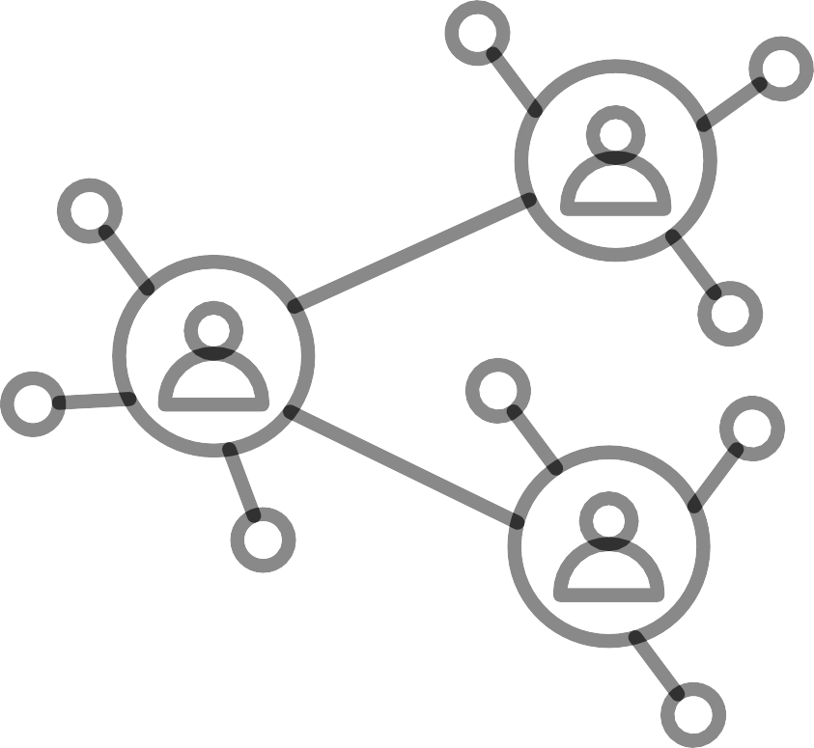
Networking
Why is Networking Important?
What is a Network?
Identification of relevant Networks
Strategic Planning of Networking

Slide 4
Why is networking important?
Joint cooperation and representation of interests are always stronger than by one actor
Exchange of knowledge
More creative power and influence
Facilitation of work (in the long term, but before that there is additional work, so don't take on too much at first, especially because many migrant organisations are dependent on voluntary work
If you work in the right networks, you can get information more quickly, influence decisions and work out and implement strategies for the development of your organisation more effectively
Perception as a successful and attractive organisation
Quickly identifying new developments and developing appropriate services
Source: Strategische Planung erfolgreicher Netzwerkarbeit- Ein Leitfaden für Migrantenorganisationen, Herausgeber: Der Paritätische Gesamtverband, 1. Auflage 2011, https://www.house-of-resources.berlin/wp-content/uploads/2017/06/A4_MSO-netzwerkarbeit_web.pdf

Slide 5
The additional workload of networking should be discussed in the context of the organisation
Values & identity of the own association should be preserved, despite activities in different networks
What are the challenges?
Networking can only have the desired effect if you have access to the most influential networks to achieve your aims. This requires an in-depth analysis of your goals, resources and relevant stakeholders
Source: Strategische Planung erfolgreicher Netzwerkarbeit- Ein Leitfaden für Migrantenorganisationen,
Herausgeber: Der Paritätische Gesamtverband, 1. Auflage 2011
https://www.house-of-resources.berlin/wp-content/uploads/2017/06/A4_MSO-netzwerkarbeit_web.pdf

Slide 6
What are networks?
"A NETWORK DIFFERS FUNDAMENTALLY FROM AN ORGANISATION IN THE PRINCIPLE OF CONTROL: INSTEAD OF A CONTROL CENTRE, SOCIAL NETWORKS HAVE A LARGE NUMBER OF NODES THAT USE THE RECIPROCAL RELATIONSHIPS IN GREAT AUTONOMY."
Here networks are symbols for the link between people.
The elements of social networks can be individuals as well as groups or organisations
Social networks have:
Common interests and intentions of actors
Personal orientation
Voluntary participation
Relationships based on the principle of exchange and mutual trust
A multitude of nodes that autonomously use reciprocal relationships
GIVE EXAMPLES OF COUNTRY AND REGIONAL- SPECIFIC NETWORKS
Source: Strategische Planung erfolgreicher Netzwerkarbeit- Ein Leitfaden für Migrantenorganisationen,
Herausgeber: Der Paritätische Gesamtverband, 1. Auflage 2011
https://www.house-of-resources.berlin/wp-content/uploads/2017/06/A4_MSO-netzwerkarbeit_web.pdf

Slide 7
Definition of Relevant Stakeholders (Stakeholder Analysis)
Stakeholder analysis is a methodical instrument of strategic management. It involves:
identification of influential interest groups from the environment of an organisation
mapping in terms of their interests and influence
strategic options for action are then to be derived from this picture
"When building local networks, existing structures must be taken into account. The actors in the local area have known each other well for a long time, also personally. The situation is characterised by established relationships of trust, often unspoken distribution of tasks and multi-layered working relationships. "
Stakeholder Analysis = finding suitable and appropriate partners for a network
In the stakeholder analysis, the interest groups relevant to the organisation should be identified and presented in terms of their influence (power) and interests.
Source: Strategische Planung erfolgreicher Netzwerkarbeit- Ein Leitfaden für Migrantenorganisationen,
Herausgeber: Der Paritätische Gesamtverband, 1. Auflage 2011
https://www.house-of-resources.berlin/wp-content/uploads/2017/06/A4_MSO-netzwerkarbeit_web.pdf
If necessary, they are analysed more intensively from certain points of view (e.g. relevance, innovation potential, need for communication, risk potential).

Slide 8
Strategic Planning of Networking
The most important element of successful networking: sharpening the profile and having goals clearly in mind!
1. . Set a goal: e.g. what does the organisation want to achieve in the next few years? Set annual goals to achieve this.
2. The defined objectives should correspond to the organisation's purpose as defined in the statute/mission, but should be concretised by concrete content (e.g. projects). The aim is to plan the implementation of the organisation's purposes and objectives in order to make participation in networks efficient.
3. Now it is a matter of finding the appropriate resources and partners that can make the achievement of the goals possible, and to achieve this by working in new as well as existing networks.
Source: Strategische Planung erfolgreicher Netzwerkarbeit- Ein Leitfaden für Migrantenorganisationen,
Herausgeber: Der Paritätische Gesamtverband, 1. Auflage 2011
https://www.house-of-resources.berlin/wp-content/uploads/2017/06/A4_MSO-netzwerkarbeit_web.pdf

Slide 9
Strategic Planning of Networking (2)
The next step in the assessment is the development of strategies for action. This entails:
Identifying the status of the relationship between key contacts to be able to plan further steps.
Mapping the contacts with regard to the status of the relationship between the contact and our organisation, starting with the contacts
Action planning to reach people:
If no relationship exists yet
Approach contact points via a third party or directly (focus on project + own strengths), cooperation partner must be convinced the cooperation is beneficial for both sides. Keep in regular contact and inform about current developments.
If the relationship already exists
Provide up-to-date information. Exchange in network meetings (working groups)
People with whom one already cooperates
Contacts are always important as a reference to get to know other important people. Maintain contact regularly
Source: Strategische Planung erfolgreicher Netzwerkarbeit- Ein Leitfaden für Migrantenorganisationen,
Herausgeber: Der Paritätische Gesamtverband, 1. Auflage 2011
https://www.house-of-resources.berlin/wp-content/uploads/2017/06/A4_MSO-netzwerkarbeit_web.pdf

Slide 10
Strategic Planning of Networking (3)
Evaluation of success: Were all the goals that were to be achieved with the cooperation fulfilled?
STEPS FOR THE EVALUATION:
Concerning the partners: Have we contacted the right people? Which ones are still missing? How can we reach them? In which committees should we participate additionally?
With regard to the goal: Is the achievement of the goal realistic in terms of costs and benefits? Is a reorientation necessary?
In relation to your own organisation: Have we used our strengths enough? Have we reduced our weaknesses?
Source: Strategische Planung erfolgreicher Netzwerkarbeit- Ein Leitfaden für Migrantenorganisation Herausgeber: Der Paritätische Gesamtverband, 1. Auflage 2011
https://www.house-of-resources.berlin/wp-content/uploads/2017/06/A4_MSO-netzwerkarbeit_web.p

Slide 11
EXCURSUS: ADVOCACY
Why do organisations do advocacy?
How to advocate successfully?
How to communicate? (Rhetorical Skills)

Slide 12
Advocacy...
Short intro exercise with group:
discuss the definitions and understandings of advocacy.
gather examples of successful advocacy campaigns from your group and discuss what was good, what changes happened due to the advocacy efforts
Advocacy is a strategy to influence decision-makers for them to change the way they decide on a specific issue.

Slide 13
Why do organisations do advocacy?
Advocating is one of the most effective ways to implement social change politically.
By demanding new rules of the game, civil society actors can address the causes of the great challenges of our time, not just their symptoms.
It is true that migrant and civil society organisations in general have fewer resources for their advocacy work compared to private corporations. But (according to Prof. Alberto Alemanno) more resources do not equate to more influence.
Source:The European guide to citizen lobbying, Brussels 2019 https://www.thegoodlobby.eu/wp-content/uploads/2019/07/Toolkit-EU.pdf

Slide 14
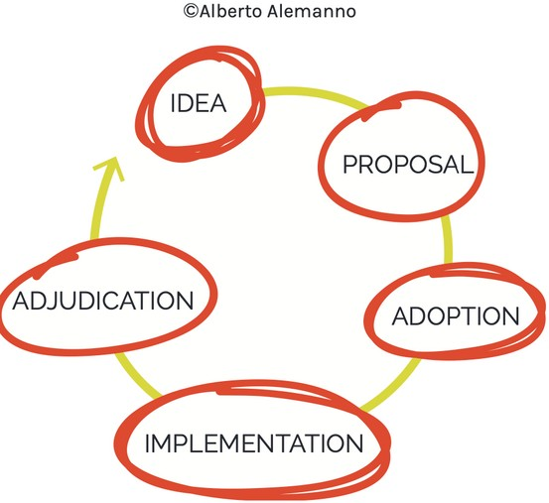
How to advocate successfully? (1)
Policy Cycle
The list of possible matters is very long, but there is a big difference between advocating on issues that were already discussed by decision makers, and those that were not!
It is important to stay informed and to know what happens in the political environment of your field of work.
It is also important to choose the right moment to advocate for your goals that you want to be included in a policy or law etc. The ability to impact a specific issue will depend on the stage of the issue in the policy cycle.
E.G.: Most interesting stages can be from the stage of idea to proposal and from proposal to adoption. In implementation stage, only implementation might be influenced - not the matter itself
Source:The European guide to citizen lobbying, Brussels 2019 https://www.thegoodlobby.eu/wp-content/uploads/2019/07/Toolkit-EU.pdf

Slide 15
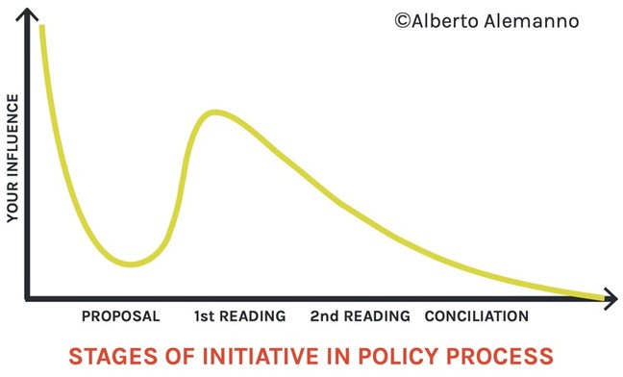
These online media outlets can also be useful for EU advocacy: Politico, The Hill or Euroactiv
How to advocate successfully (2)
Remember: The sooner you become involved, the more scope you have for your impact in a matter!
Different countries and administrations publish the legislative initiatives through their official websites.
For example: https://eur- lex.europa.eu/homepage.html? locale=en https://www.europarl.europa.eu/legislative-train/
INCLUDE COUNTRY+ REGIONAL SPECIFICS
For example: when a regulatory proposal is already drafted, it will be difficult to change it. But if you are able to campaign to change that proposal as it moves through the legislative process, your impact could be taken into account.
Source:The European guide to citizen lobbying, Brussels 2019 https://www.thegoodlobby.eu/wp-content/uploads/2019/07/Toolkit-EU.pd

Slide 16
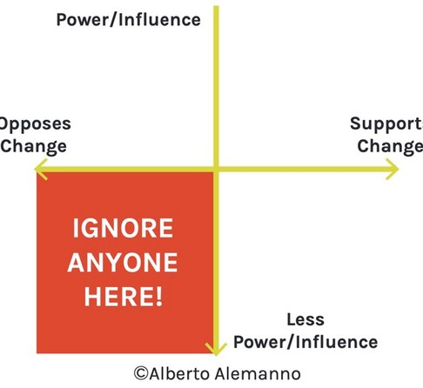
Stakeholder Mapping
Stakeholder mapping helps you better understand who can be your allies and who stands in your way. That is why it is a key strategy for successful networking as well as advocacy work. It also helps you to form coalitions!
4 important groups:
policymakers and representatives: this should be your main focus as they have the power to implement/change policies/laws;
allies: NGOs, mgrant organisations, like-minded organisations and experts who can share their resources and knowledge;
opponents: actors who disagree with you and may be against your interests;
influencers: non-expert people who have the power to influence the public opinion and your targeted groups in a formal or in-formal way
Source:The European guide to citizen lobbying, Brussels 2019 https://www.thegoodlobby.eu/wp-content/uploads/2019/07/Toolkit-EU.pdf

Slide 17
10 Steps in Advocacy Planning*
Gather friends!
Set the goal & objectives
Identify the problem
Map the arguments
Identify your targets
Who are your allies?
What resources are needed?
Design the action plan
Implement, monitor, evaluate
Celebrate successes!
Source: Training Kit for Empowering Refugee-Led Community Organisations, 2022, https://aditus.org.mt/our-work/projects/training-kit-for-empowering-refugee-led-community-organisations/

Slide 18
10 Steps in Advocacy Planning
Gather friends!
Look for people who share your concerns.
Are there existing groups or networks covering your goals?
Engage with them in meetings.
A joint agenda would be great.
Think long-term partnerships, not simply one-off cooperation.

Slide 19
10 Steps in Advocacy Planning
Identify the problem
Think of the actual problem(s) faced: not the main issue, the real problems!
What is the cause of the problem?
Try to identify the structural issue: a law, policy or rule.
What are the concrete effects of the problem?

Slide 20
10 Steps in Advocacy Planning
Set the goal & objectives
GOAL: The change you want to see.
Focus on an end, not a means or a tool.
Make sure it is clear to all.
OBJECTIVES: What is needed for the change to happen?
Be SMART!

Slide 21
What is a SMART objective?
Specific
Measurable
Achievable
Relevant
Time-based

Slide 22
What is a SMART objective?
Smart
Well-defined (who, what...)
Clear
Measurable
How will you recognise success?
Are you able to observe progress?
Achievable
Is it actually possible?
Resources? Timing? Capacity?
Relevant
Time-based
To the Goal
Helps achieve the goal
Have a time-frame
Sufficient but not excessive

Slide 23
10 Steps in Advocacy Planning
Map the arguments
Research: gather the facts!
Who is affected? Particular groups?
Any existing research?
Official data & statistics?
Document it!

Slide 24
Identify your targets
Who has the power?
Possible multiple decisions or decision-makers
Tailor the strategy
Understand the context

Slide 25
10 Steps in Advocacy Planning
Who are your allies?
How about a coalition?
Who can endorse, support?
Who are your opponents?
Ensure clarity + agreement on the goal and objectives!
Respect differences!

Slide 26
What resources are needed?
What do you have? (skills, tools, funds...)
How are you going to get there?
What is reasonable needed for yours goals and objectives?

Slide 27
Design the action plan
Direct
Letters
Petitions
Public education
Campaigns
Meetings
Government officials
Partners
Phone calls
Reports
Events
Articles
Refugees
Media
Go ahead
& be
creative!

Slide 28
Implement, monitor, evaluate
What is the activity?
What resources are needed?
Who is responsible for it?
How to we measure performance?
What is our Plan B?

Slide 29
10 Steps in Advocacy Planning
Monitoring & evaluation
Monitoring is a regular collection of info and data to measure changes over a period of time.
Evaluation looks at the direction of an activity and makes a judgement on progress and impact.
What has changed? What were our aims? What have we (not) achieved?

Slide 30
Celebrate successes!
Boosts morale
Lessons learnt
Strengthens accountability
Shares good practice

Slide 31
Exercise
Identify a challenge/ problem your organisation / you have been trying to influence and change
Use the 10 Steps in Advocacy Planning to create your own strategy!
Listen and respect each other!

Slide 32
How to communicate (1)
Communicating advocacy actions means communicating information and winning the attention of at least 3 different target groups:
Decision-Makers
Media
Public Opinion
HOWEVER SOMETIMES ONE CAN BE ENOUGH.
Use different tools and mix them up to achieve your own goals:
Traditional media: opinion articles, interviews, letters, quotes
Digital media: blogs, personal websites, social networks and events: press conferences, workshops, seminars, sit- ins, hackathons
Distribution of instructive material: infographics, brochures, gadgets
publication of formal acts: petitions and complaints
Source:The European guide to citizen lobbying, Brussels 2019 https://www.thegoodlobby.eu/wp- content/uploads/2019/07/Toolkit-EU.pdf

Slide 33
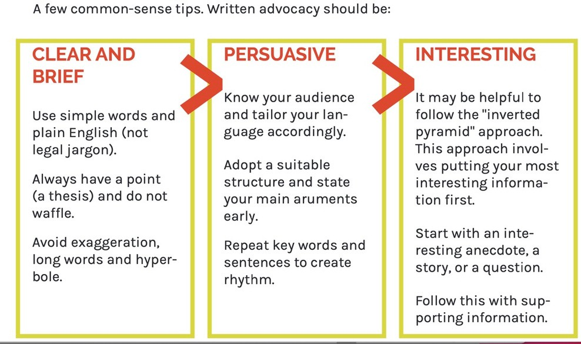
How to communicate (2)
Source:The European guide to citizen lobbying, Brussels 2019 https://www.thegoodlobby.eu/wp-content/uploads/2019/07/Toolkit-EU.pdf

Slide 34
How to communicate (3)
Spoken Advocacy (Rhetorical Skills)
Ethos - The speaker’s power to enhance their personal character and credibility.
Appear likeable and professional; come prepared;
clear and concise delivery
Pathos - The speaker’s power to stir emotion of the audience.
Tell a coherent and consistent story;
highlight the most important and compelling facts.
Logos - The speaker’s power to prove their argument.
Carefully structure your argument; select your key issues;
develop a coherent theme
Source:The European guide to citizen lobbying, Brussels 2019 https://www.thegoodlobby.eu/wp-content/uploads/2019/07/Toolkit-EU.pdf

Slide 35
Self-advocacy
Self-advocacy is being able to speak up for yourself and being able to ask for the things that are important to you. Self-advocating is saying what you think and asking for what you want and need, this is because you know you best and people need to listen to you if you are not happy or you want something to change (source and more info on self-advocacy: https://www.rethinkessexadvocacy.org/media/to0h313r/taking-control-a-guide-to-self-advocacy.pdf)
Useful toolkit on self-advocacy that focuses on three steps that can help us to improve the way we communicate while we self-advocate: knowledge, skills and confidence.
Read up more and use the toolkit in your trainings!
https://advocacyfocus.org.uk/wp-content/uploads/2022/04/The_Essential_Self_Advocacy_Toolkit_1119.pdf

Slide 36
Links for Further Reading
Add national and local Links!
https://www.thegoodlobby.eu/wp-content/uploads/2019/07/Toolkit-EU.pdf
https://www.transparency.de/fileadmin/Redaktion/Publikationen/2014/Lobb ying_in_Germany_TransparencyDeutschland_2014_EN.pdf

